Slide 1
Angular Momentum Guided
Motion Concatenation
Hubert P. H. Shum
Taku Komura
Pranjul Yadav
School of Informatics
University of Edinburgh
Indian Institute of Technology Guwahati

Slide 2
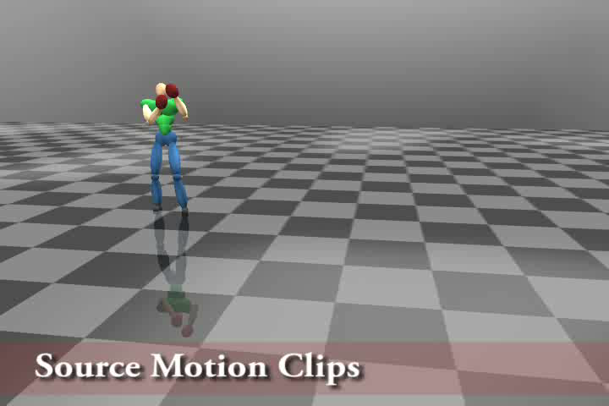
Conducting Multiple Actions Successively

Slide 3
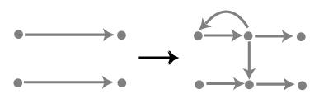
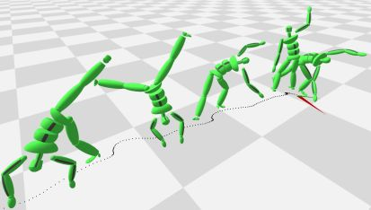
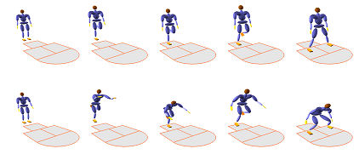
Related Works
Kovar et al. 2002
Motion Graphs
Heck et al. 2007
Parametric Motion Graphs
Liu et al. 2002
Synthesis of Complex Dynamic Character Motion from Simple Animations

Slide 4
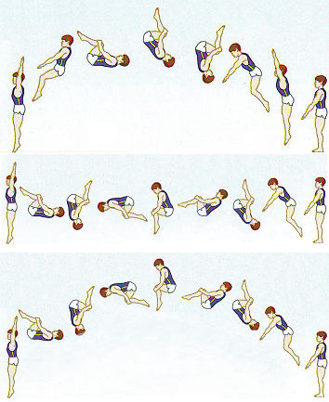
Related Works
Majkowska et al. 2007
Flipping with Physics

Slide 5
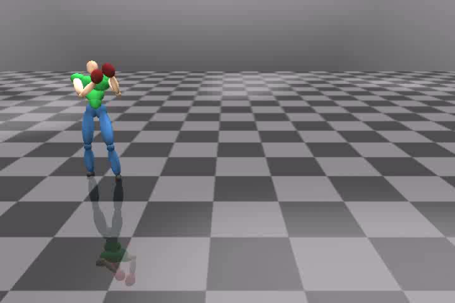
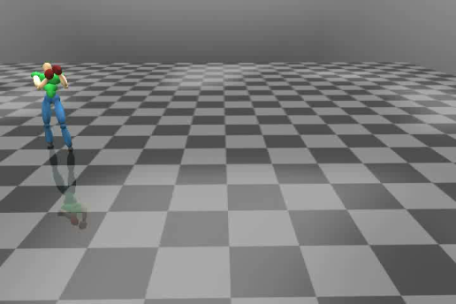
System Overview
1. Identifying potential alignment period
2. Finding the optimal alignment
3. Blending the aligned motions
Angular
Momentum
Angular
Momentum
Time
Time
Motion 1
Motion 2

Slide 6
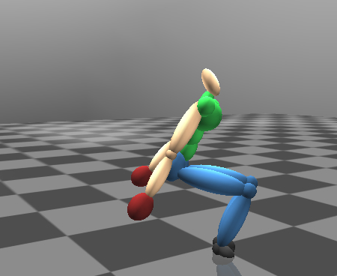
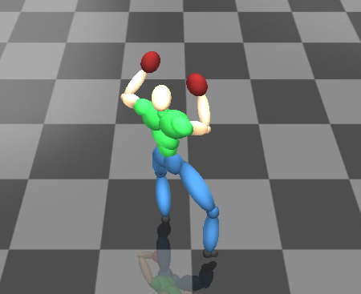
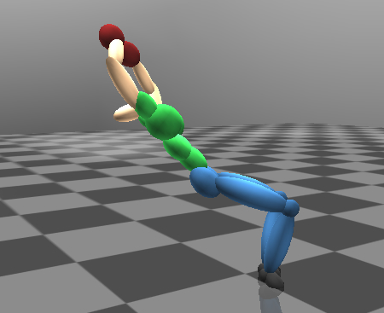
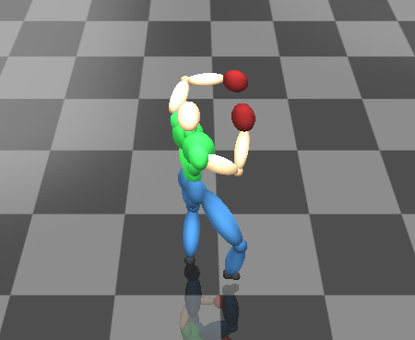
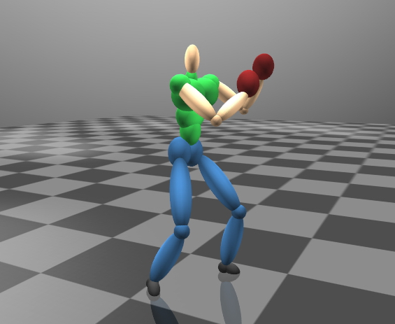
Typical Angular Momentum Trajectories of Full-Body Motions
Main Phase
Angular
Momentum
Preparatory
Phase
Posterior
Phase
Time

Slide 7
Forward Rule for Potential Alignment Period
Keeping the angular momentum of the first motion to perform the second motion

Slide 8
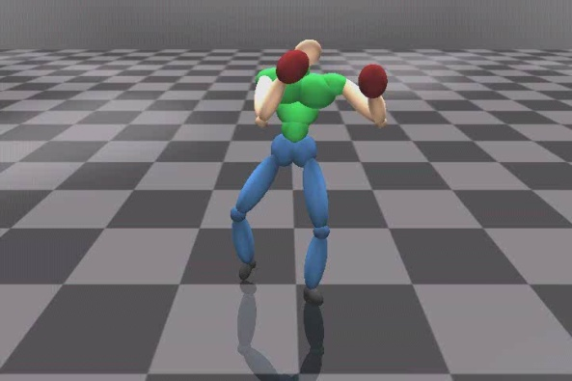
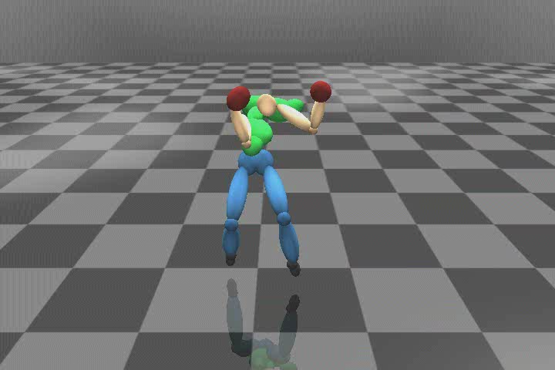
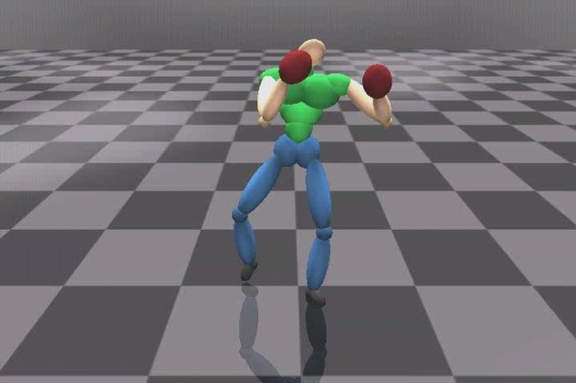
Forward Rule: Example

Slide 9
Reverse Rule for Potential Alignment Period
Using the angular momentum of the first motion to prepare the second motion

Slide 10
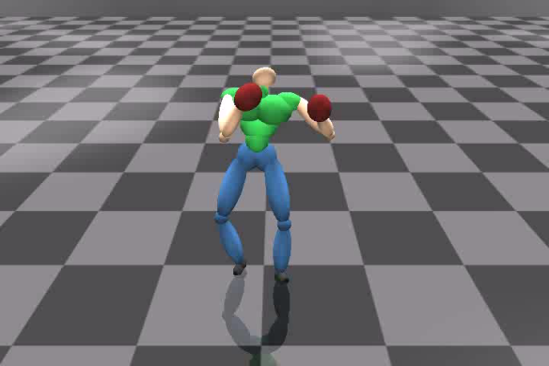
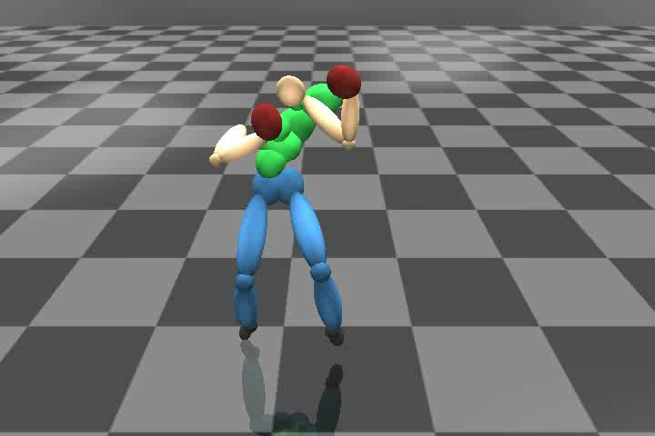
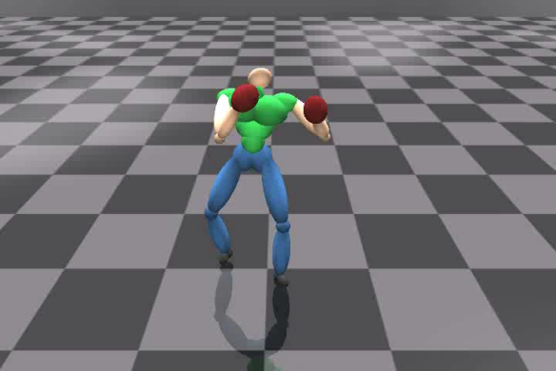
Reverse Rule: Example

Slide 11
Blending Two Motions with
Optimal Alignment
F = F_{dm} + F_{inertia} + F_{time}

Slide 12
F_{dm}: Minimizing Difference In
Angular Momentum
Angular
Momentum Y
F_{dm}
Angular
Momentum X
Angular
Momentum Z

Slide 13
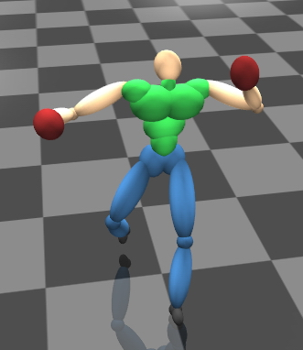
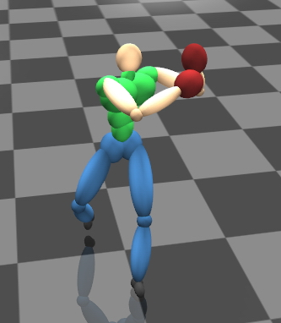
F_{inertia}: Minimizing the Different in
Moment-of-Inertia
F_{inertia}
Angular
Momentum
Time

Slide 14
F_{time}: Minimizing the
Time to Start Interpolation
Angular
Momentum
F_{time}
Time

Slide 15
Motion Blending and
Angular Momentum Smoothing
Angular Momentum
Time

Slide 16
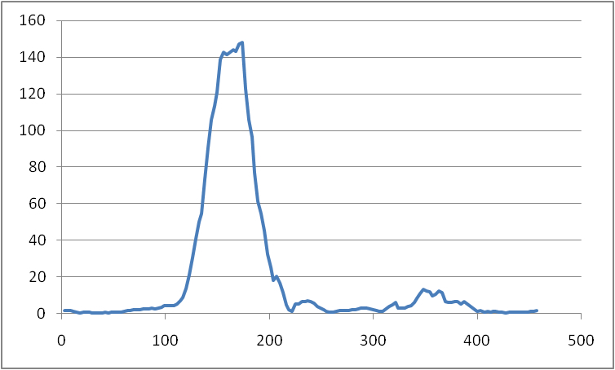
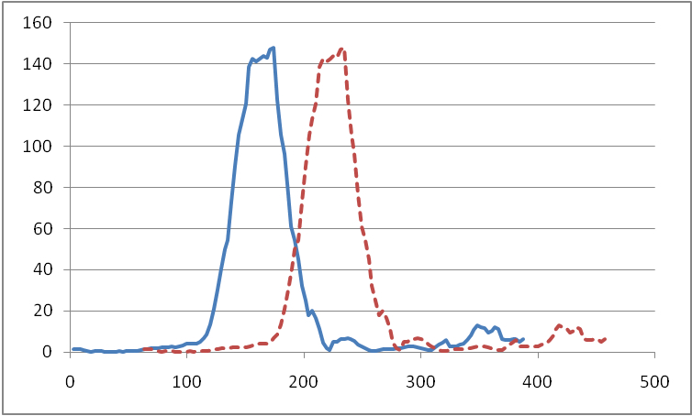
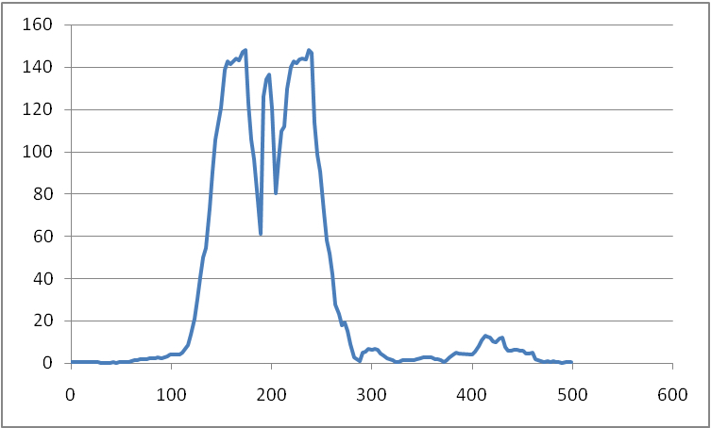
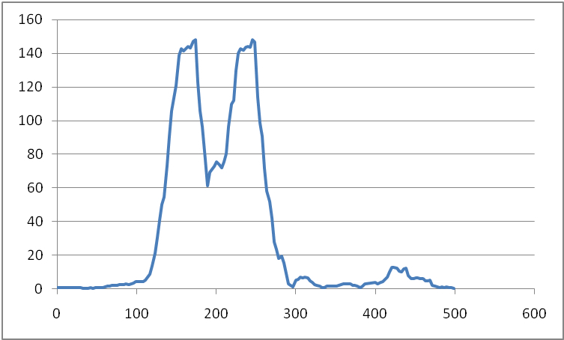
Angular Momentum Smoothing

Slide 17
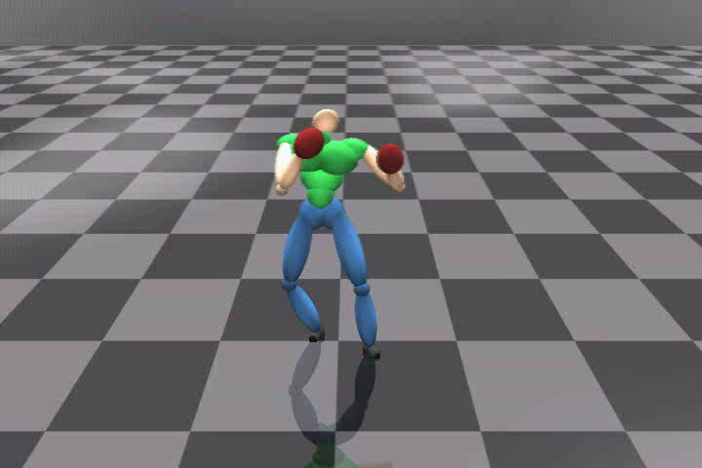
Comparison to Motion Graph

Slide 18
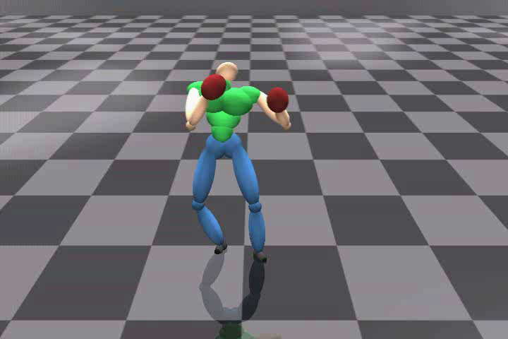
Comparison to Motion
Performed by Real Human

Slide 19
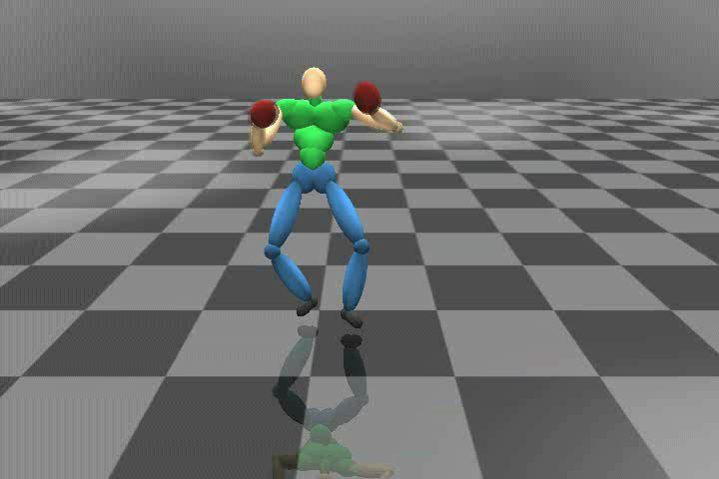
Synthesizing Long Sequence of Motion

Slide 20
Discussions
Angular momentum based concatenation
  Natural motion transition
  Better controllability for character
Offline process
  Online by precomputating all edges in a Motion Graph
Future works
  Physical correctness
  Independent measures for the motion quality

Slide 21
Conclusion
Concatenate two full-body motion based on angular momentum
Propose the forward and reverse rules to identify the potential alignment periods
Design an objective function to find the optimal alignment
Smooth the angular momentum in the resultant motion by scaling

Slide 22
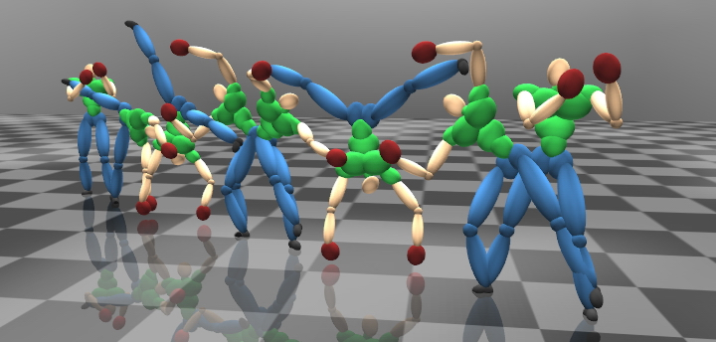
Thanks
Any Questions?

Slide 23
Angular Momentum
p
L = m ∙ r x p
L: angular momentum
m: mass
r: moment arm vector
p: linear velocity
r
L

Slide 24
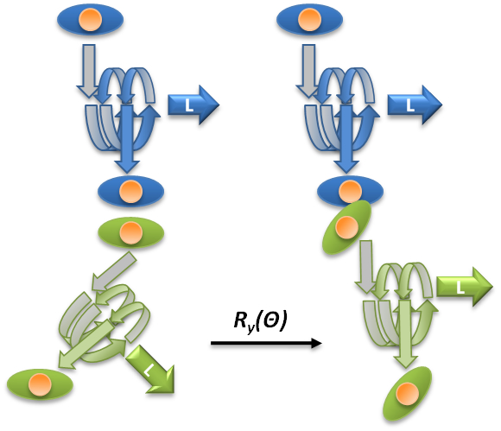
Spatial Alignment

