Slide 1
Preparation Behaviour Synthesis with
Reinforcement Learning
Hubert P. H. Shum
Northumbria
University
Ludovic Hoyet Trinity College
Dublin
Edmond S. L. Ho
Hong Kong Baptist University
Taku Komura
University of Edinburgh
Franck Multon
University Renne 2

Slide 2
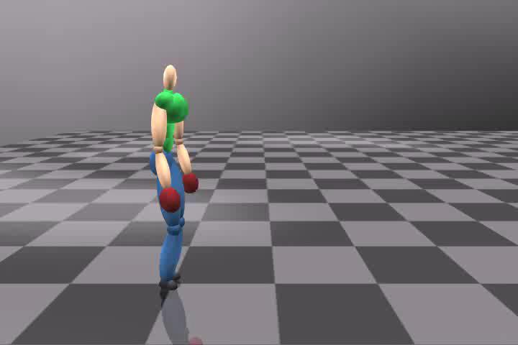
Problem in Traditional Motion Synthesis

Slide 3
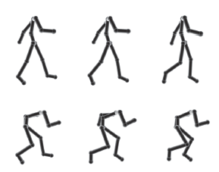
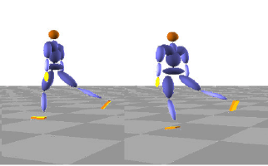
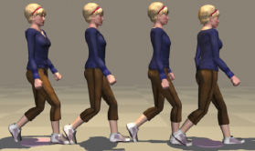
Previous Works
Hsu et al. 2005
Style Translation for
Human Motion
Liu et al. 2002
Synthesis of Complex
Dynamic Character Motion
from Simple Animations
Safonova et al. 2007
Construction and Optimal
Search of Interpolated
Motion Graphs

Slide 4
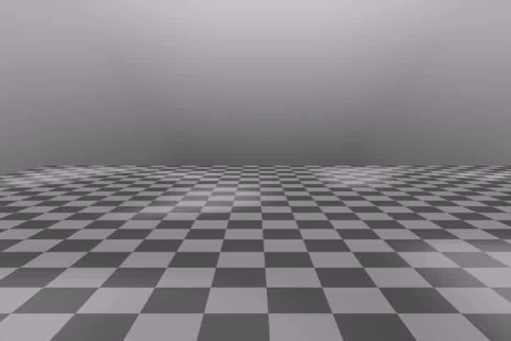
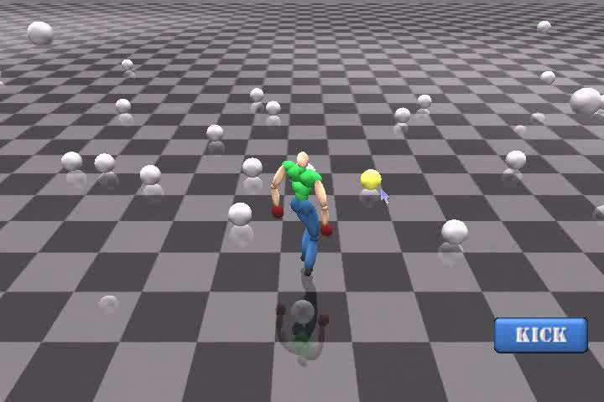
System Overview
Hierarchal Motion Graph
Reinforcement Learning
Optimal Motion &
Level of Preparation
Motion Synthesis
Environment
Movement with Preparation Behaviour

Slide 5
Hierarchical Motion Graph
Crawl
Jump
Stand
Walk
Kick
Duck
Punch
Core nodes (red): Cyclic locomotion
Supporting nodes (green): Target motion to interact with the environment
Edges: Valid transition of motion with no kinematics artifacts

Slide 6
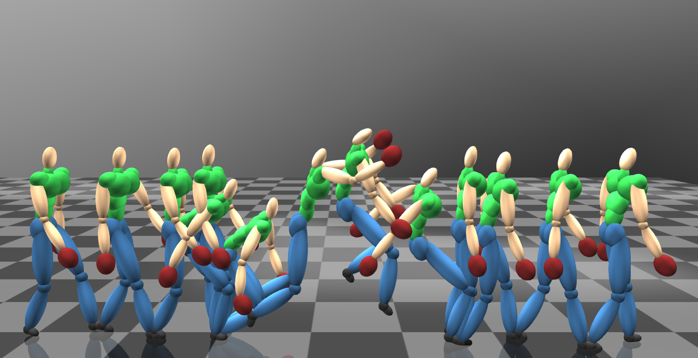
Reference Posture Extraction
Search from T_{t} to T₀ for a posture that:
1. The center of mass of the body is within the supporting area
2. The contact foot pattern is the same as that of T₀
3. The sum of squares of lower body posture difference with respect to T₀ within threshold
A Typical Action in the Motion Graph
Transition From Locomotion
Target Movement
Transition To Locomotion
Reference Posture
T₀: First Frame of Action
T_{t}: First Frame of Target Movement

Slide 7

Movement Style Synthesis
The preparation movement is synthesized by blending a locomotion to the reference posture of a target motion
  q^{i}: blended joint angle of joint i
  q^{i}_{𝓛} : joint angle in the locomotion
  q^{i}_{𝓣p}: joint angle in the reference posture
  w^{i}: blend weight

Slide 8

Blend Weight Control
The blend weight is controlled indirectly by the system through the degree of preparation, α
  C_{i}: constant to represent the blending behaviour of a joint
  E.g. C_{i}=0.5 C_{i}=1.0
  By default, C_{i} is set to 1.0 for lower body joints, 0.5 for upper body joints
w
w
α
α

Slide 9
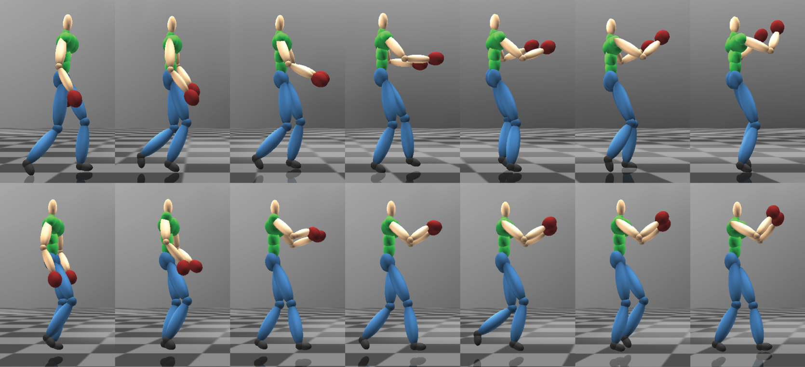
The Effect of the C_{i} in Blending
Upper: Traditional linear blending
Lower: The proposed blending equation with C_{i} = 0.5

Slide 10
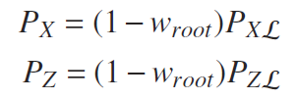

Movement Trajectory Adjustment
The horizontal displacement of the root is calculated by its blend weight
  P_{X𝓛}, P_{Z𝓛} : root position of the locomotion in the X, Z axis
  w_{root}: blend weight of the root
The vertical direction is calculated based on the feet positions
  P_{Y𝓛}: root position of the locomotion in the Y axis
  △Y_{l}, △Y_{r}: height change of the left and right feet relative to the root caused by blending the lower body joints

Slide 11
Controller for the Preparation Behaviour
We have created a framework to synthesize to synthesize preparation movement based on
  The motion for the character to approach a target, m
  The level of preparation to create preparation movement, α
We need a controller to control the two parameters and generate the preparation behaviour
  Reinforcement learning

Slide 12

State and Action Representation
State:
  α: current level of preparation
  Next(m): The set of next available motion
  d_{g}, d_{i}, Ɵ_{g}, Ɵ_{i}: distance and angle towards the goal and the source of influence
Action:
  α: next level of preparation
  m: next motion
Ɵ_{i}
Ɵ_{g}
Source
of Influence
d_{i}
d_{g}
Goal
α
Next(m)

Slide 13




Reward Function
Face target:
  s_{t+1}: next state
  Ɵ_{g}: angle towards target
Move towards target:
  s_{t}: current state
  d_{g}: distance to target
Stabilize level of preparation change:
  α: level of preparation
Reward:

Slide 14
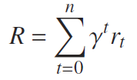
Reinforcement Learning with SARSA
SARSA is used to train the policy and maximize the long term reward
  r_{t}: reward at step t
  γ: discount factor

Slide 15
Experiment Setup
Intel Dual-Core 3.0 GHz CPU with 2GB of RAM
Database with 78 motions
Offline reinforcement learning: 1 hour
Online motion synthesis: real-time

Slide 16
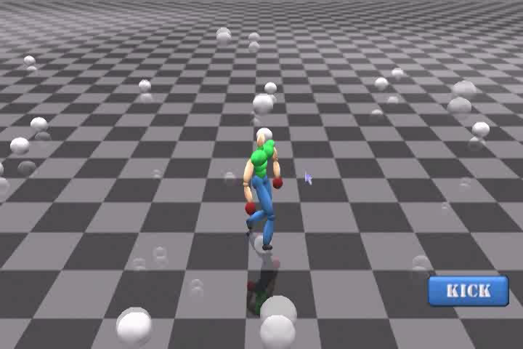
Interacting with Balls

Slide 17
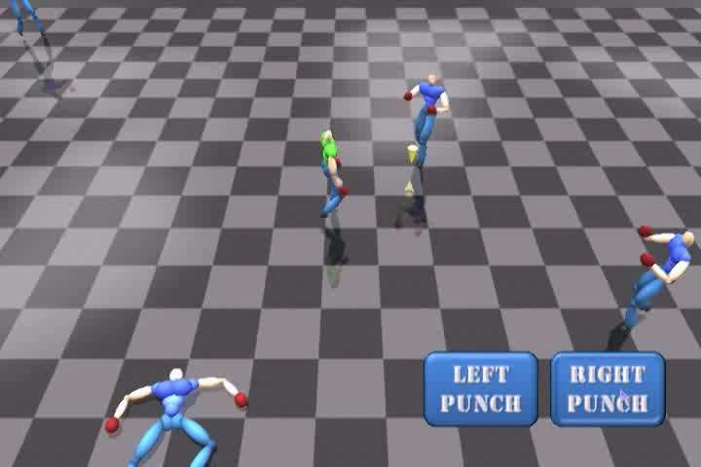
Fighting with NPCs

Slide 18
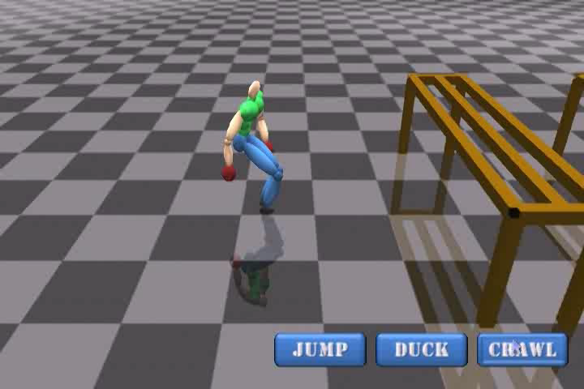
Navigating in a Complex Environment

Slide 19
Conclusion and Discussions
Preparation behaviour
  Motion blending to synthesize movements
  Reinforcement learning to control behaviour
Can enhance animations and console game experiences
Minimum motion used in the database, as the preparation movement is synthesized
Future direction: Synthesizing preparation behaviour for multiple potential target motions

Slide 20
Thanks!
Any Questions?

