Slide 1



Multiclass-SGCN: Sparse Graph-based Trajectory Prediction with Agent Class Embedding
Ruochen Li, Stamos Katsigiannis and Hubert P. H. Shum
Department of Computer Science
Durham University
Notes:
Hi everyone, my name is Ruochen Li from the department of computer science in Durham University. Today I am going to introduce our paper for ICIP conference, the title of our work is Multiclass-SGCN: Sparse Graph-based Trajectory Prediction with Agent Class Embedding.

Slide 2
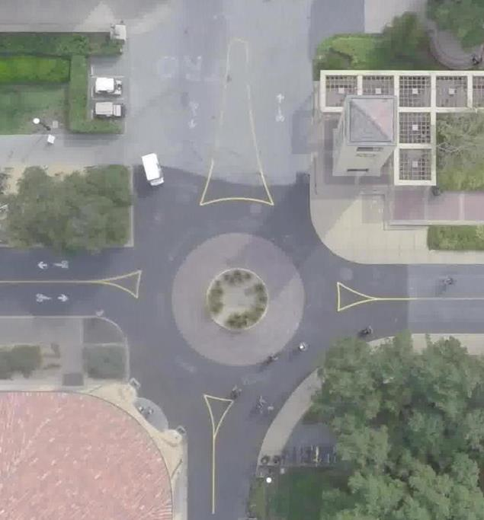
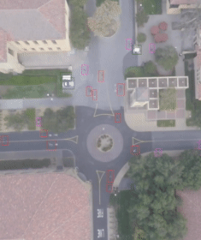
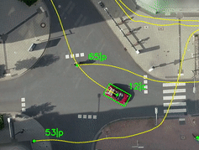
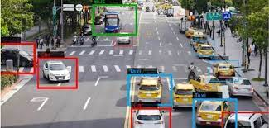
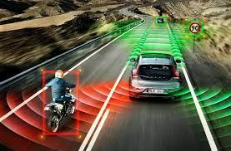
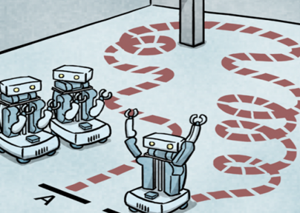





Introduction
Observations:
Figure 1. SDD Dataset [1] (Left) and InD Dataset [2] (Right)
Video surveillance
Collision avoidance
Path planning
Prediction:
Applications
Minimize
Ground truth:
Notes:
With the development of autonomous system, trajectory prediction has gradually become important in different applications such as Video Surveillance for crowded analysis, collision avoidance for self-driving vehicles, path planning for robotics. In this paper, we tackle the problem of trajectory prediction for multi-class agents in real-world traffic scenarios as shown in Figure 1. Intuitively, to define the task of trajectory prediction, given the scene and observation trajectories goes from t one to t observation (usually it is 8 time steps); Together in the dataset, we have the data pair of the observations called ground truth from t observation plus 1 to t prediction. Which can be seen in green line;
In the task, what we are looking for is Y hat, a prediction for each time step. the optimization goal here is to minimize the distance between the prediction and the ground truth.

Slide 3

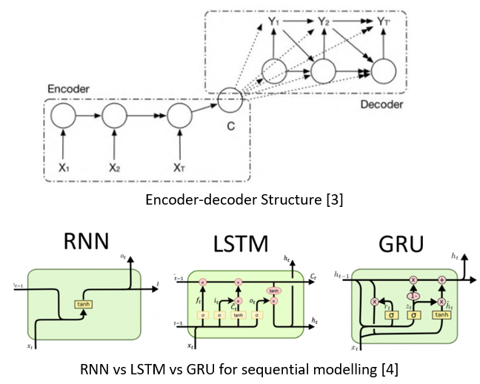
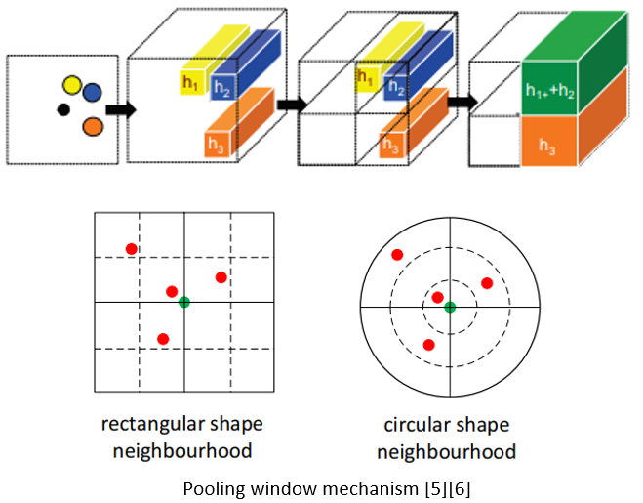
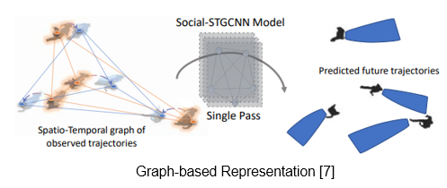
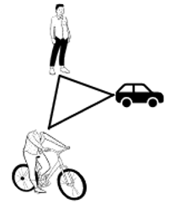
Challenges
Motion Preference
Agent-agent Interactions
Notes:
However, trajectory prediction remains a challenge because of several factors; The first challenge is how to model the motion preferences for different types of agents. For example, pedestrians, bikes, and vehicles have different movement speed, movement patterns, even for pedestrians, different person has different preferences.
The other challenge is the agent-agent interactions, for example, pedestrian may focus more on the movement of vehicles than other pedestrians since the discrepancy of dangerous level.
To this end, many existing works intend to use Recurrent based methods to model the motion preference of individual agent, such as Recurrent neural network, long short-term memory network and gated recurrent network with Encoder-decoder structures. However, these methods exist inherent problems such as gradient vanishing and exploding.
For interactions modelling, previous researches apply pooling window mechanism to model the interactions between agents if they are categorized within the same windows. Moreover, recent works apply Graph neural network to represent the spatial and temporal dependencies of the multi agent trajectories.

Slide 4














Motivation
Pedestrian-oriented trajectory prediction can not fully describe the crowded scene
Graph Neural Network can better model the social interactions
Not all the neighbours can bring important impacts for each agent when planning for the next movement
Vehicle
Pedestrian
Biker
Vehicle
Vehicle
Pedestrian
Notes:
The motivation of our work contains three main points, the first one is Pedestrian-oriented trajectory prediction can not fully describe the crowded scene because there also existing also agents such as vehicles, bikers;
The second motivation is that we Graph Neural Network can better model the social interactions due to its ability to represent non-Euclidean data; The last motivation is that Not all the neighbours can bring the same important impacts for each agent, so it is important to dynamically and adaptively construct the interactions between agents.

Slide 5
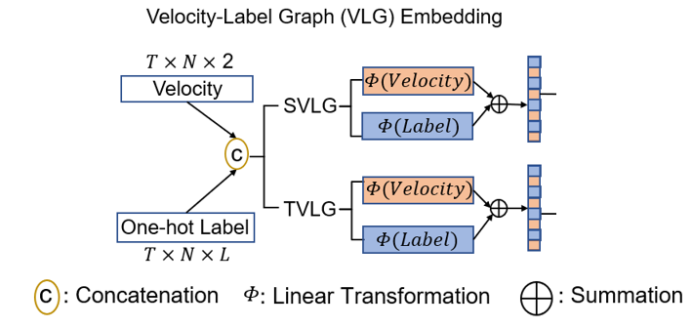
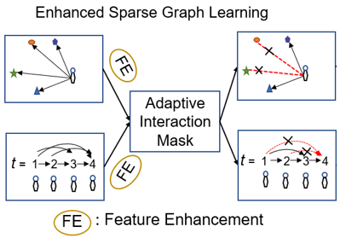
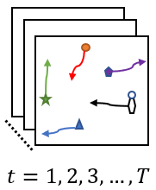
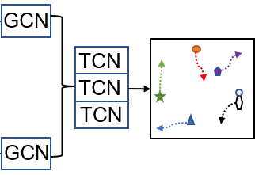
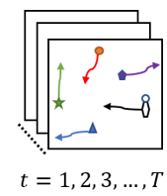
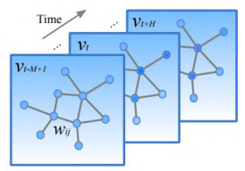
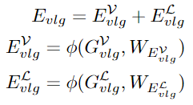


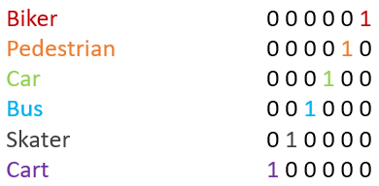

Methodology
Spatial
Attention
Temporal
Attention
Absolute Position:
2-D coordinate (x, y)
SVLG
T x N x 8
Class Label:
Car, Pedestrian, Biker…
TVLG
N x T x $9^{∗}$
*Positional Encoding
Notes:
Here is the overview of our proposed multi-class SGCN, our system consists of three main components, the first one is to construct the graph representation of trajectories; The input data contains two parts including 2-D coordinates of each agent at each time step and its corresponding label, here we applied one-hot encoding to transform the text label to machine readable format, and finally concatenating these two features together.
Then we create spatial-temporal graphs SVLG and TVLG, where T is the number of frames, N is the number of agents; At each timestep in SVLG, the nodes of the graph are all the agents in that frame; In TVLG, the nodes of the graph are al the time steps of each individual agent. Moreover added one extra dimension as positional encoding in temporal velocity-label graph.
After constructing the graph presentation, we separately embedded the velocity and label features to get the embedded features of each graph Esvlg and Etvlg.

Slide 6
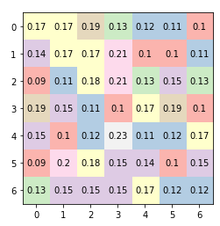
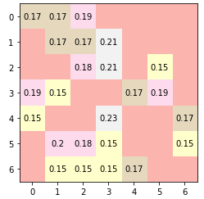
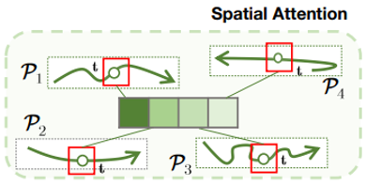
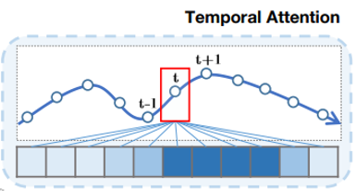
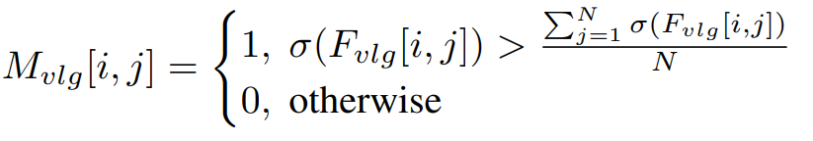
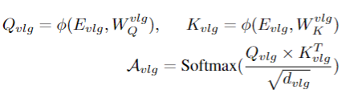
Methodology
Spatial
Attention
Temporal
Attention
Feature Enhancement
Asymmetric conv
1x1 conv
Dense spatial adjacency Matrix
Sparse spatial adjacency Matrix
Adaptive Interaction Mask
Dense temporal adjacency Matrix
Sparse temporal adjacency Matrix
Notes:
The second component of our system is Enhanced sparse graph learning part. After obtaining the embedded features of spatial velocity label graph and temporal velocity label graph. We applied self-attention mechanism for both of them. For spatial velocity label graph, the spatial attention scores are computed using all the agents at each timestep, where the temporal attention scores are computed with all the timesteps for each individual agent.
These two attention modules will then generate dense spatial adjacency matrix and dense temporal adjacency matrix, we further introduce a feature enhancement module with asymmetric convolutional operations to extract high-level interaction features from these two adjacency matrices. Besides, we introduces 1 by 1 convolution for into spatial adjacency matrix along its temporal channel to extract temporal dependencies.
The high-level interaction features will then be passed into our proposed Adaptive interaction mask module, which can dynamically and adaptively filter out those un-important neighbours for each node in the graph. This adaptive interaction mask will then help us to get sparse spatial adjacency matrix and sparse temporal adjacency matrix.

Slide 7
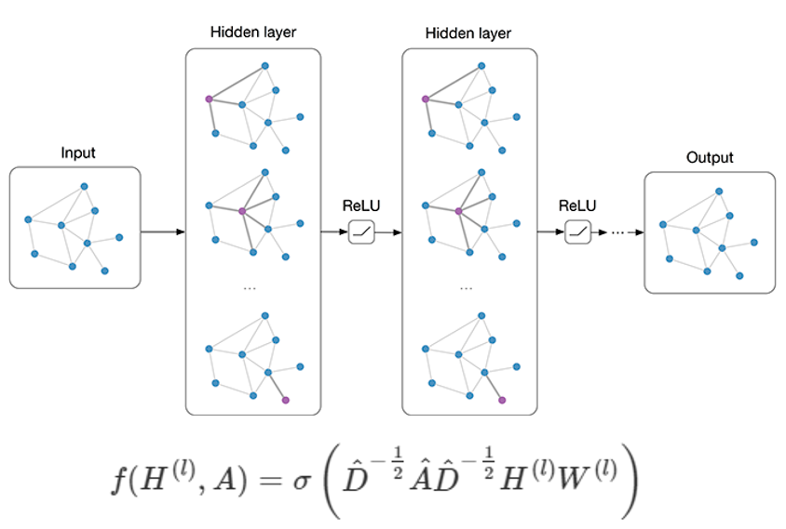
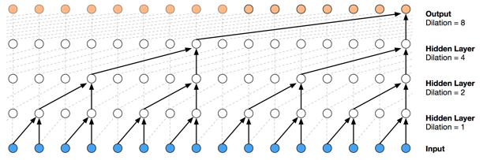

Methodology
Spatial
Attention
Temporal
Attention
SVLG
Bivariate Gaussian
TVLG
Graph Convolutional Networks [8]
Temporal Convolutional Networks [9]
Notes:
The last component of our system is to aggregate the node features for both spatial velocity label graph and temporal velocity label graph; After obtaining the sparse adjacency matrices of both graphs, We applied Graph convolutional Network to aggregate the nodes of both sparsed spatial velocity label graph and sparsed temporal velocity label graphs. Besides, Graph convolutional Network can also learn the trajectory representation. The aggregated features of both graphs will then be fused together.
Finally, we introduce temporal convolutional network to model the trajectory representations which can effectively capture temporal dependencies without gradient vanishing problems.
Following previous research, we assumes the predicted trajectories follow the bivariate gaussian distribution, and thus the outputs of temporal convolutional networks are parameters of the bivariate distributions.
The overall system can be trained by minimizing the negative log-likelihood loss.

Slide 8
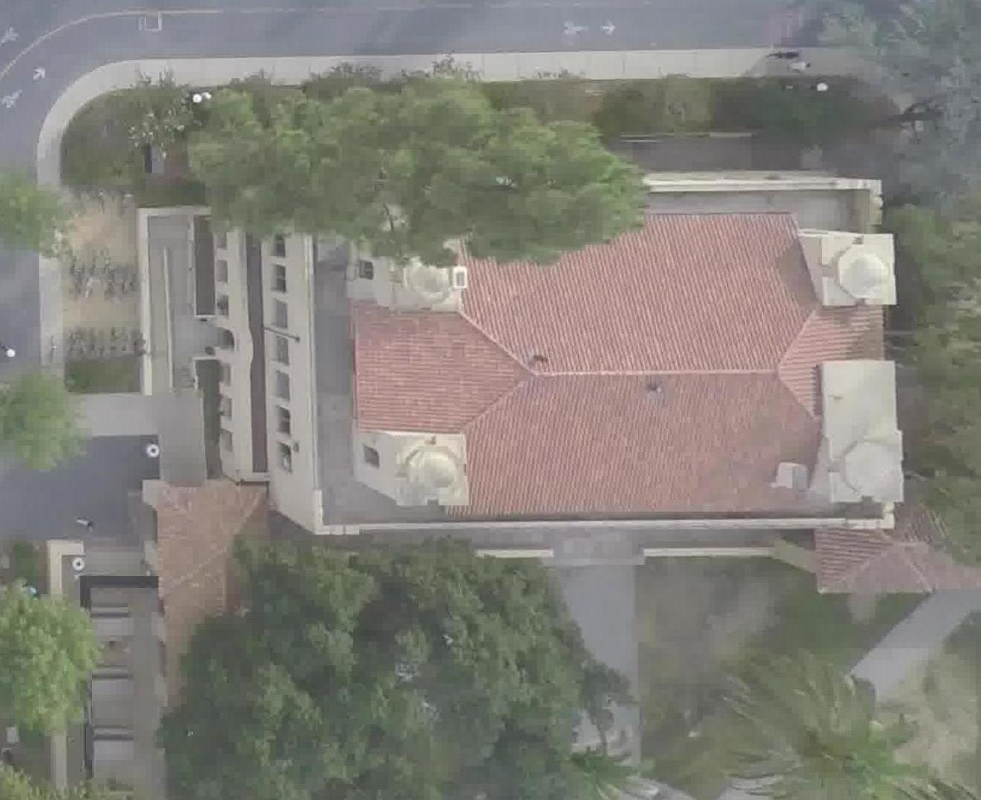
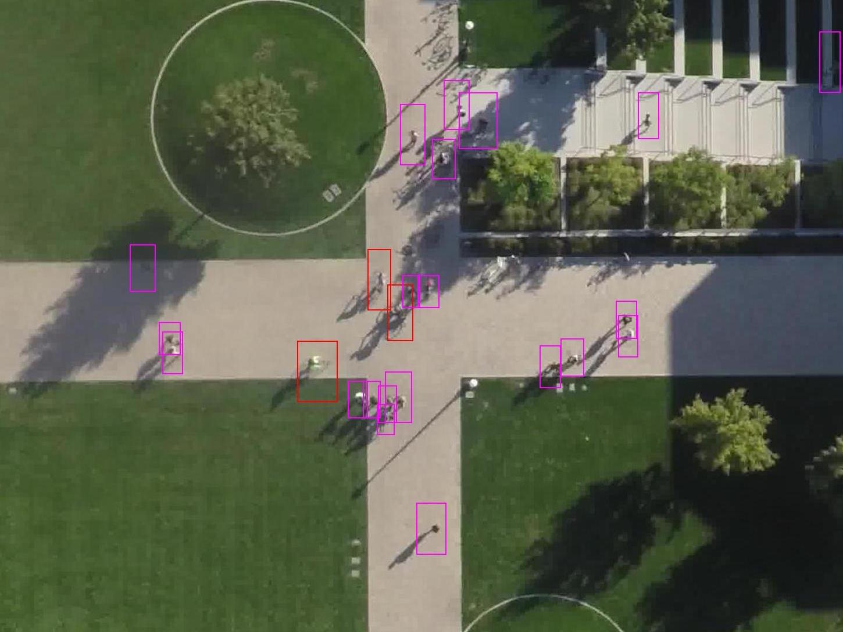


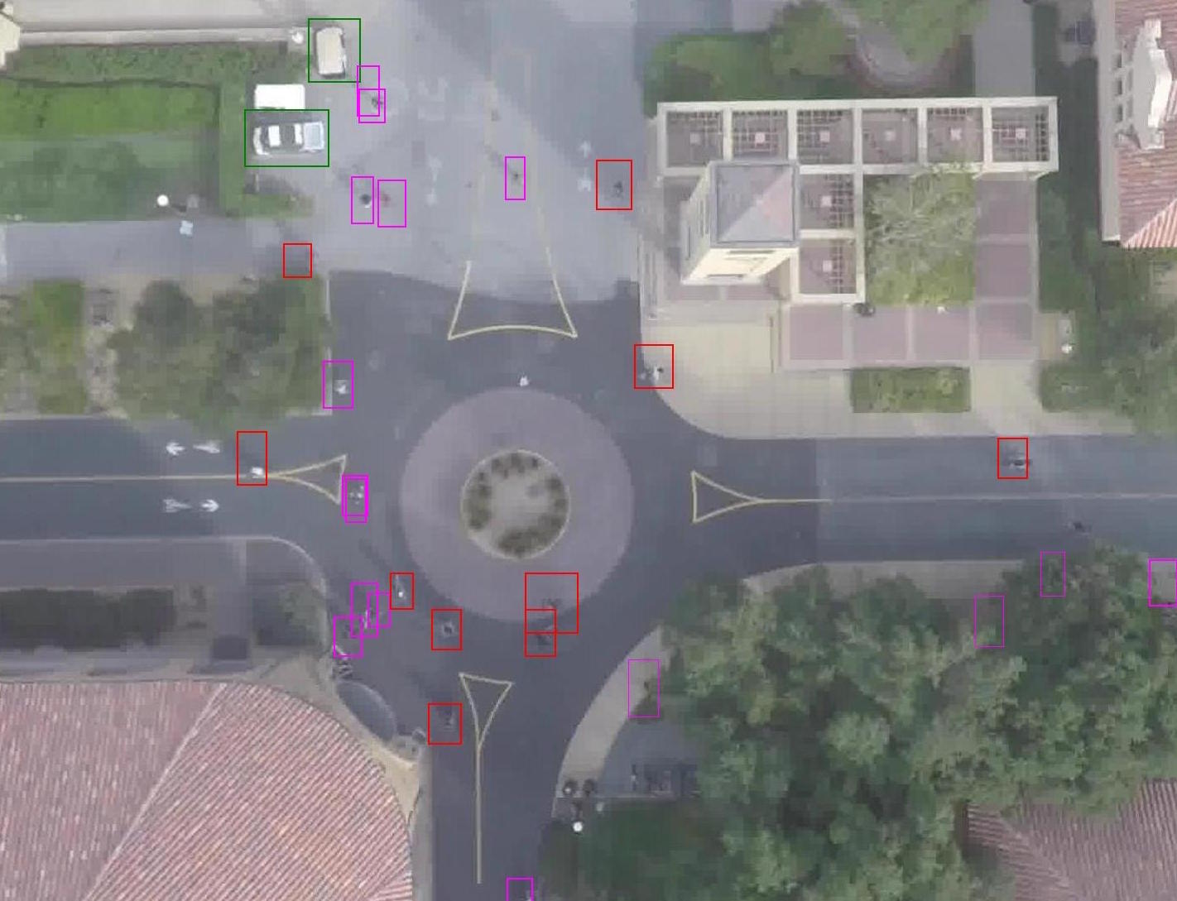
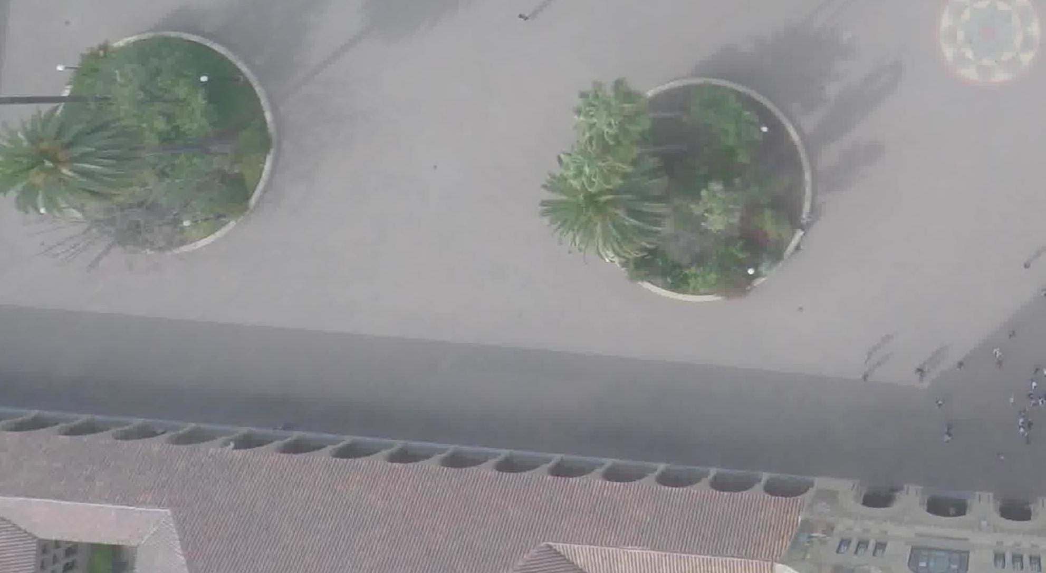


Experiment
Experiment Dataset
Evaluation Metrics: Displacement Error
Minimum ADE (mADE)
Minimum FDE (mFDE)
Average ADE (aADE)
Average FDE (aFDE)
Stanford Drone Dataset [1]
  Six classes of Objects:
  pedestrians, bicyclists, skateboarders, cars, buses, carts
  Evaluation Settings:
  Predicted future 12 frames (4.8s) with 8 observed frames (3.2s)
  Bird-eye views captured by drones in the campus
  There are overall 8 scenes captured in the dataset

Slide 9
Results
Quantitative Results
Multiclass-SGCN perform well under various evaluation metrics (Both model uses class labels)
Multiclass-SGCN achieves best performance compare with other SOTA methods
SE: Separable Embedding (Label and Velocity)
CL: Class Label
AIM: Adaptive Interaction Mask

Slide 10
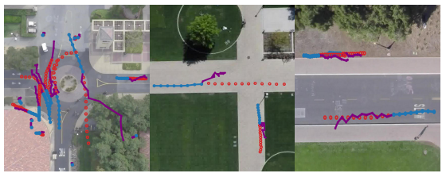
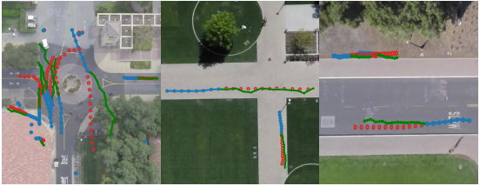
Results
Qualitative Results
  Semantic-STGCNN [10]
  Multiclass-SGCN (Ours)
Multiclass-SGCN generates more realistic and reasonable trajectories
Multiclass-SGCN generates trajectories with low diversity and amplitude

Slide 11
Summary
1. We propose Multiclass-SGCN, a GCN for predicting multi-class agent trajectories, which outperforms state-of-the-art methods
2. We propose a novel algorithm to separately embed the correlated features of class label and velocity, resulting in an optimal embedding for different natures of input features
3. To create sparse attention of neighbours from different classes, we propose an adaptive interaction mask that adaptively filters neighbours of lower influence.
4. Source codes available at: https://github.com/carrotsniper/multiclass-sgcn
Notes:
To address the issues, we have taken into account human-understandable features, such as human skeleton features, object bounding box, joint and object velocities. We have developed context-informed ASSIGN to further improve HOI recognition accuracy.
This is the diagram of the input features in our context-informed ASSIGN. Except for original 2048-dimensional human and object ROI features, we have a novel input stream, which applies ST-GCN to extract the spatio-temporal relationships from human 2D skeleton data and object bounding box in the CAD-120 dataset. Here the skeleton has 18 dimensions and OBB has 20 dimensions. We use a 19x19 adjacency matrix and a 19x2 weight matrix, both are learnable in the optimisation process through back-propagation. These two matrices are subsequently multiplied, resulting in a 19x2 matrix as input of ST-GCN. The number of input channel and output channel of ST-GCN are set to 2 and 128, through convolutions we obtain an output vector of 19x128 dimensions. This is then concatenated with joint and object velocity features. // Therefore, the three main input streams here are: 2048-dimensional human and object ROI features, and extra 2470-dimensional contextual features. They are embedded through their own MLP with corresponding dimensions and then uniformly output their respective features with the same dimension of 512. After this input embedding, the three input streams input into the attention operator in ASSIGN, to calculate the interacted relations between human, object and context-based skeletons.

Slide 12
Thanks
[1] Bryan Anenberg. "Stanford Aerial Pedestrian Dataset.," YouTube, Dec. 20, 2015 [Video file]. Available: https://www.youtube.com/watch?v=c6xQ6iz6wH8&t=3s.
[Accessed: Dec. 14, 2021].
[2] ﻿J. Bock, R. Krajewski, T. Moers, S, Runde, L. Vater, and L. Eckstein, “The inD Dataset: A Drone Dataset of Naturalistic Road User Trajectories at German Intersections,” ﻿arXiv preprint arXiv:1911.07602, 2019.
[3] Chenglei Peng, Yang Li, Yao Yu, Yu Zhou, and Sidan Du. Multi-stepahead host load prediction with gru based encoder-decoder in cloud computing. pages 186–191, 01 2018. 10
[4] dprogrammer. “RNN, LSTM & GRU.,”. Apr. 6, 2019. Available: http://dprogrammer.org/rnn-lstm-gru. [Accessed: June. 14, 2022].
[5] Hao Xue, Du Q. Huynh, and Mark Reynolds. Ss-lstm: A hierarchical lstm model for pedestrian trajectory prediction. In 2018 IEEE Winter Conference on Applications of Computer Vision (WACV), pages 1186– 1194, 2018.
[6] Alexandre Alahi, Kratarth Goel, Vignesh Ramanathan, Alexandre Robicquet, Li Fei-Fei, and Silvio Savarese. Social lstm: Human trajectory prediction in crowded spaces. In 2016 IEEE Conference on Computer Vision and Pattern Recognition (CVPR), pages 961–971, 2016.
[7] M. Abduallah, Q. Kun, E. Mohamed, and C. Christian, “Social-stgcnn: A social spatio-temporal graph convolutional neural network for human trajectory prediction,” in IEEE/CVF CVPR, 2020, pp. 14412–14420
[8] Kipf. T. GRAPH CONVOLUTIONAL NETWORKS. Sep. 30, 2016. Available: https://tkipf.github.io/graph-convolutional-networks/. [Accessed: June. 19, 2022]
[9] S. Bai, J. Z. Kolter, and V. Koltun, “An empirical evaluation of generic convolutional and recurrent networks for sequence modeling,” CoRR, vol. abs/1803.01271, 2018.
[10] B. A. Rainbow, Q. Men, and H. P. H. Shum, “SemanticsSTGCNN: A semantics-guided spatial-temporal graph convolutional network for multi-class trajectory prediction,” in IEEE SMC, 2021, pp. 2959–2966.

