Slide 1
Physically-based Character Control in Low Dimensional Space
Hubert P. H. Shum
RIKEN
Taku Komura
University of Edinburgh
Takaaki Shiratori
Carnegie Mellon University
Shu Takagi
RIKEN

Slide 2
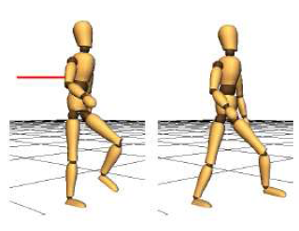
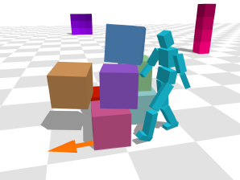
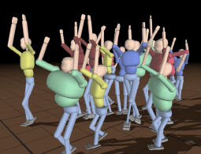
Dynamics Character Controller
Yin et. al. 2007
SIMBICON: Simple Biped Locomotion Control
Lee et. al. 2010
Data-Driven Biped Control
Coros et. al. 2010
Generalized Biped Walking Control
Notes:
A Controller is Usually Optimized in a Specific Environment

Slide 3
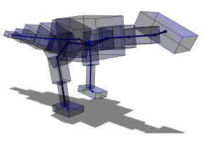
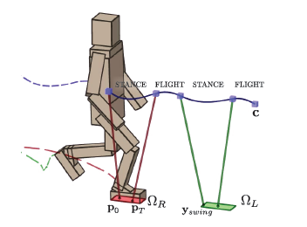
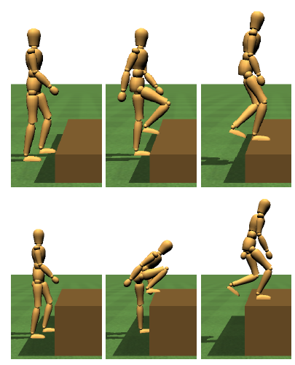
Dynamics Controller Synthesis
de Lasa et. al. 2010 Feature-based Locomotion Controllers
Mordatch et. al. 2010
Robust Physics-based Locomotion using Low Dimensional Planning
Yin et. al. 2008
Continuation methods for Adapting Simulated Skills

Slide 4
Objective & Overview
Synthesize new controllers using pre-computed ones
  Based on run-time environment parameters
  Real-time synthesis
  Stable controllers
Initial Controller
Continuous Optimization
Covariance
Matrix Adaptation
Controller Database
Landmark Isomap
Interpolated Controllers

Slide 5
Dynamic Feedback Controller
Control the character with feedback torque and keyframes
τ = k_{p}(θ_{d}-θ) + k_{d}(θ’_{d}-θ’)
Number of control parameters =
no. of keyframe * no. of DOF * 4

Slide 6
Objective Functions to
Evaluate a Controller
Stability: Maximize duration of stable walking
Motion style: Minimize difference with respect to captured motion
Gains: Minimize gains that activate the joints
Controller difference: Minimize changes on the controller

Slide 7
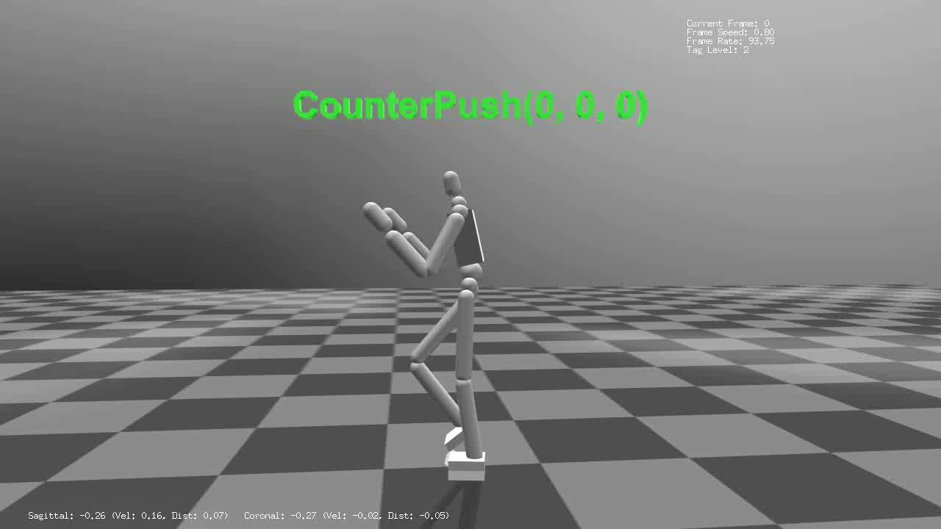
Sample Problem: Pushing the Character

Slide 8
Continuous Optimization
Control Parameter 1
Unstable Controller
Sample Controllers
Initial
Controller
Stable Controller
Optimal
Controller
Best Sample
Stable Controller for 10N
Push with 20N
Initial Controller
Push with 10N
Unstable Controller
Control Parameter 2

Slide 9
Continuous Optimization
Control Parameter 1
Stable Controller for 20N
Push with 30N
Stable Controller
for 30N
Stable Controller for 10N
Push with 20N
Control Parameter 2

Slide 10
Covariance Matrix Adaptation
Control Parameter 1
Stable Controller
for 30N
Stable Controller for 20N
Push with 30N
Stable Controller for 10N
Push with 20N
Initial Controller
Push with 10N
Control Parameter 2

Slide 11
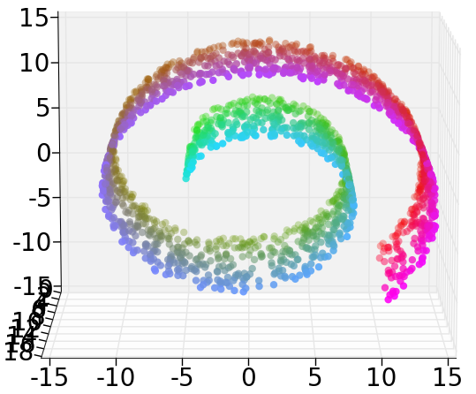
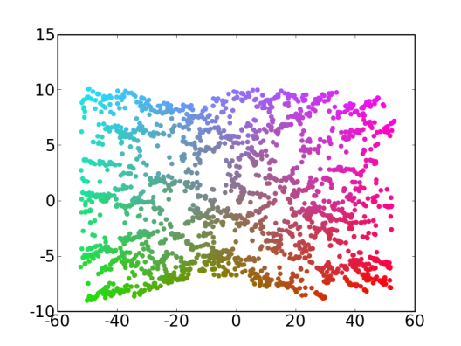
Interpolation with Isomap
Full Dimensional Space
Reduced Space

Slide 12
Isomap in Our Problem
30N Controller
Corresponding Controller in the
High Dimensional Space
25N Controller by Linear Interpolation?
25N Controller by
Linear Interpolation
in the Non-Linear
Low Dimensional Space
20N Controller
10N Controller
0N Controller
0N
10N
20N
30N
Non-Linear Dimensionality Reduction
Low Dimensional State Space

Slide 13
Experiment Setup
Pushing force: 0N to 130N continuous
Continuous optimization: Every 2N step
Total optimal controller: 66
Total sampled controller for Landmark Isomap: 2822
Training time required: 20 hours with Duo Intel Xeon W5590

Slide 14
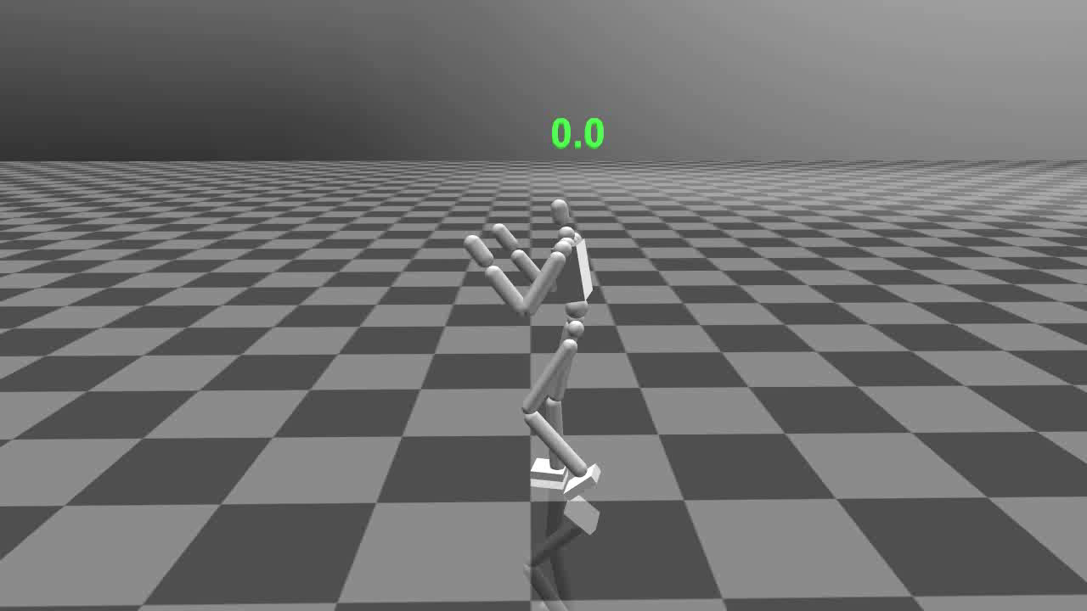
Pushing Controller Interpolation

Slide 15
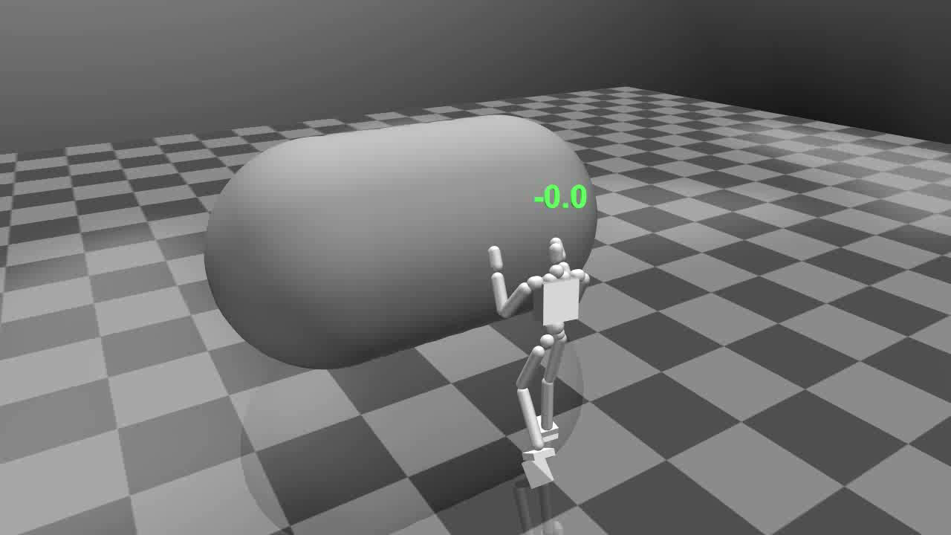
Cooperatively Pushing a Large Object

Slide 16
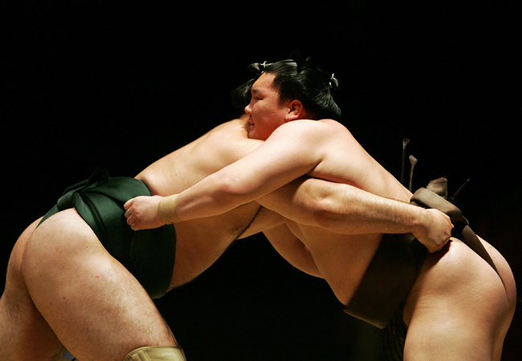
Discussion and Future Works
Inversed Pendulum Model
Linear relationship between environment parameter and controller space
Stable space for run-time optimization
0N
0N
5N
5N
1N
3N
1N
2N
3N
4N
2N
4N
0N
5N
0N
5N

Slide 17
Thanks!
Any Questions?

Slide 18
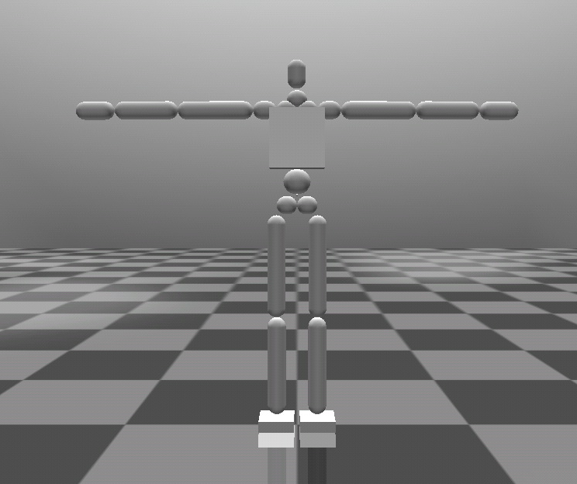
Character Model
14 joints
18 degrees of freedom
160cm and 70kg

Slide 19
Optimization with Random Sampling
Manually design an initial controller
Sample controllers by updating the initial controller
Evaluate the controllers with an objective function
Update the initial controller with the best sample

Slide 20
Objective and Overview
Synthesize new controllers using pre-computed ones
  Based on run-time environment parameters
  Real-time synthesis
Update Environmental Parameters
Initial Controller
Optimization Step
Optimization Step
Covariance Matrix
Covariance
Matrix Adaptation
Controllers
Continuous Optimization
Optimization Engine
Controller Database
Non-Linear Dimensionality Reduction
Project to
Full Dimensional Space
Interpolated Controllers
Landmark Isomap
Linear Interpolation

Slide 21
Continuous Optimization
Continuous Optimization
Update Environmental Parameters
Initial Controller
Optimization Engine
Manually design an initial controller
Generate a set of environmental parameters
Optimize and store the controller based on the parameters
Update the environmental parameters
Optimize again

Slide 22
Covariance Matrix Adaptation
Update Environmental Parameters
Initial Controller
Optimization Step
Covariance Matrix
Covariance
Matrix Adaptation
Controllers
Continuous Optimization
Get the environmental parameters
Use the covariance matrix to sample controllers
x = x_{ref} + σN(0, C)
Get a better controller from the samples
Update the covariance matrix based on good samples

Slide 23
Landmark Isomap
Controller Database
Dimension ↓
Dimension ↑
Interpolated Controllers
Linear Interpolation
Landmark Isomap
Prepare a set of controllers
Apply Landmark Isomap for dimensionality reduction
Create a non-linear low dimensional space
Linear interpolate controllers in the low dimensional space based on environment parameter
Project the interpolated controllers to the full dimensionality space

Slide 24
Landmark Isomap
Construct a connectivity map using K nearest neighbor
Calculate a distance matrix that contains the distance between any two samples by Dijkstra’s algorithm
Calculate the eigenvectors of the matrix by multidimensional scaling

