Slide 1
Topology Aware Data-Driven
Inverse Kinematics
Edmond S. L. Ho
Hong Kong Baptist University
Hubert P. H. Shum
Northumbria University
Yiu-ming Cheung
Hong Kong Baptist University
P. C. Yuen
Hong Kong Baptist University

Slide 2
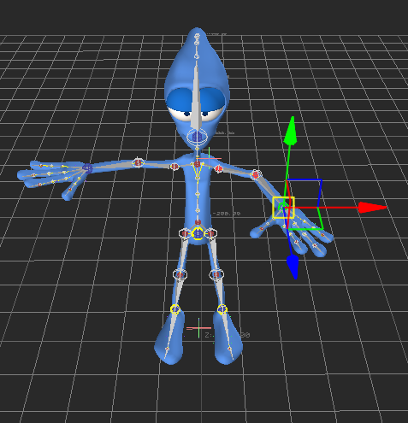
Inverse Kinematics (IK)
An efficient tool for human movement design
  Position constrain → Body joint angle
  Good for movement with dense interactions
Problem: Produced motion may not necessary be natural

Slide 3
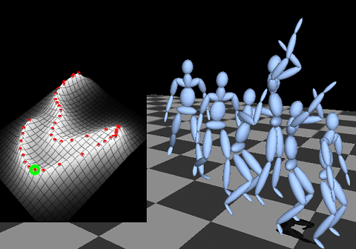
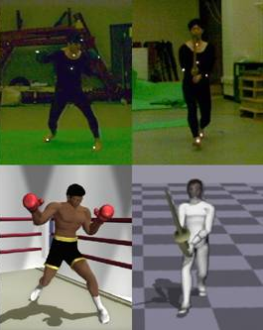
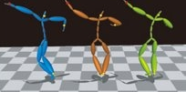
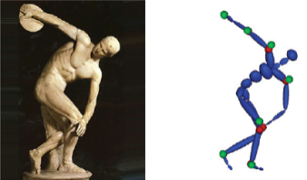
Data-Driven Inverse Kinematics
Considering naturalness based on captured motion
  When calculating joint angle based on positional constraints, favoring those similar to the captured motion
Computational cost increasing with database size
  Using only the part of the database that is related to the current posture
  Local space commonly known as “natural posture space”
Wu et al. 11
Grochow et al. 04
Chai and Hodgins 05
Wai and Chai 11

Slide 4
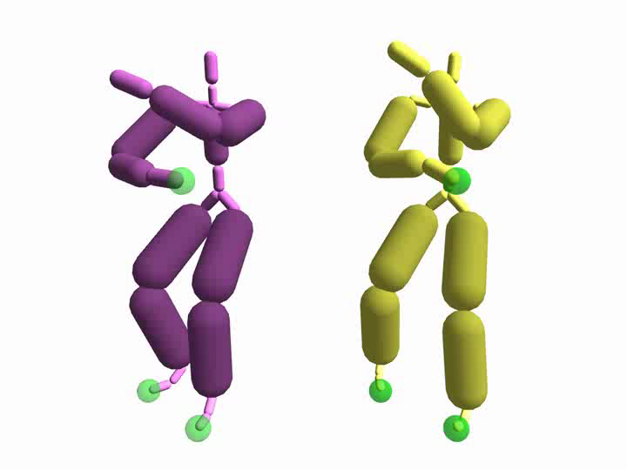
Problem in Traditional Data-Driven IK
Postures represented by low-level features such as joint positions and angles
  Cannot represent the spatial relationships between body segments
  Cannot represent the spatial relationships between segments and nearby objects
Easily resulted in collisions and penetrations for postures
  Especially with multiple constraints

Slide 5
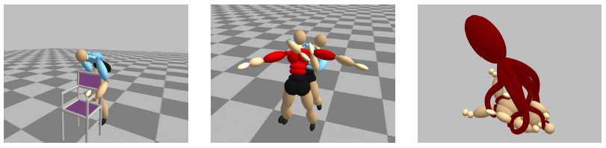
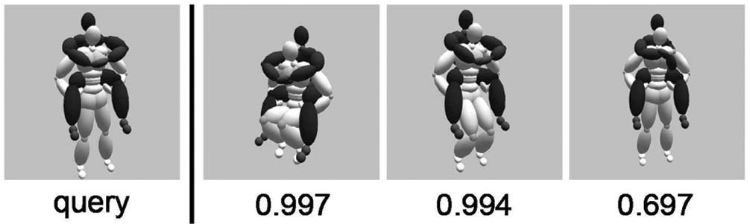
Topology-Based Motion Synthesis
Evaluating posture in the topology space that represents spatial relationships
  Using tangle based relationships called Gauss Linking Integral (GLI) to describe a posture
  Synthesis in the topology space never resulted in penetration
Ho and Komura 09a
Ho and Komura 09b

Slide 6
Topology-Based Inverse Kinematics
Applying topology concepts onto the problem of IK
Creating penetration free IK

Slide 7
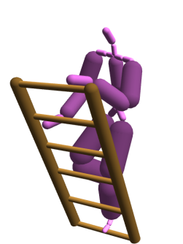
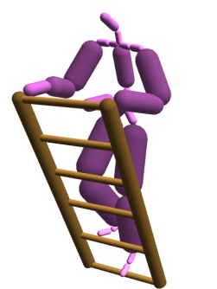
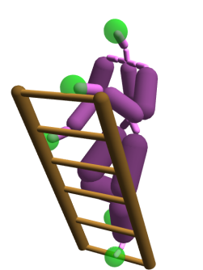
System Overview
Current Posture
Posture & GLI
Database
Local Principal Component Analysis
Synthesized Posture
User Input
Posture Synthesis with
GLI Constraints
Latent Space

Slide 8
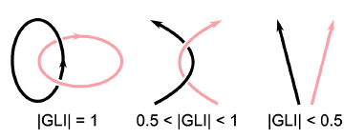
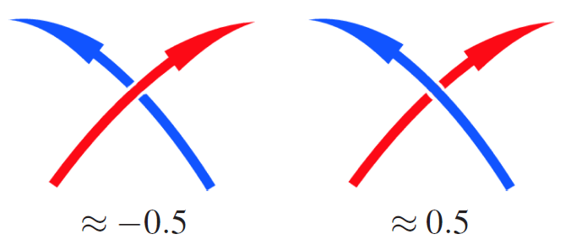
Gauss Linking Integral (GLI) for Representing String Relationships
Describing how two strings γ₁ and γ₂ twisted around each other
Degree of twisting represented by the magnitude of the GLI value
Twisting order represented by the sign of the GLI value

Slide 9
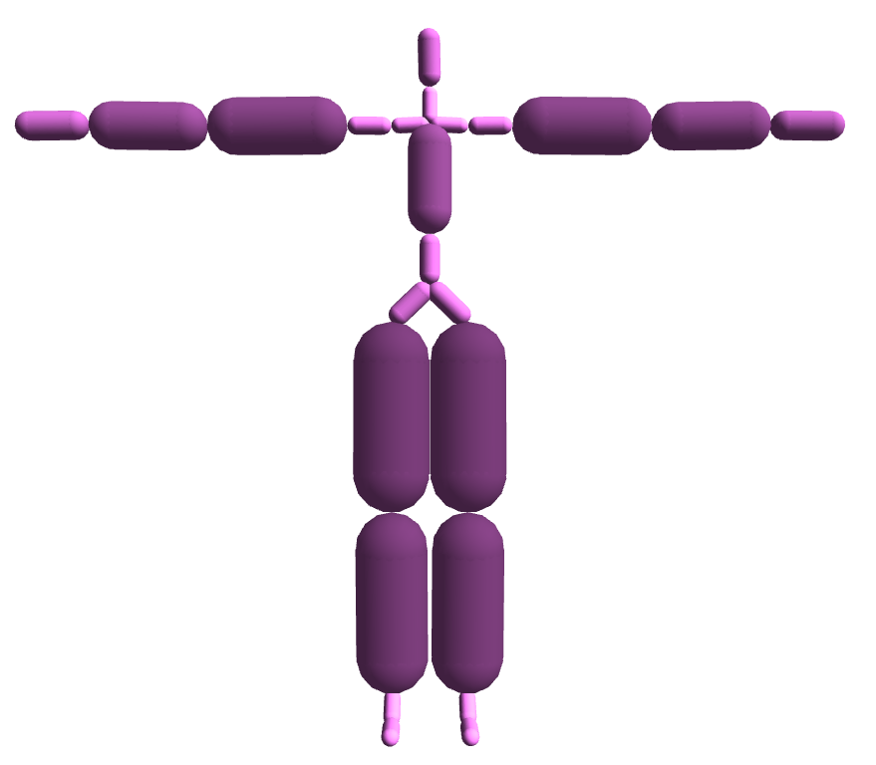
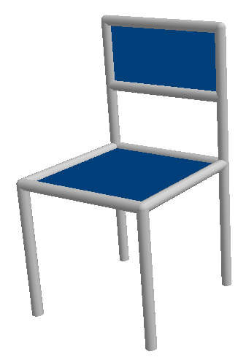
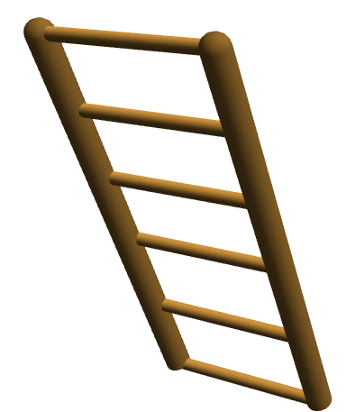
Topology Representation of Objects
Using strings to represent human body and objects
Using GLI (i.e. tangles between string pairs) to represent spatial relationships

Slide 10
Posture Database with GLI Values
A posture database to store natural postures captured from real human
Database containing:
  Posture in joint angles
  Posture in GLI representation
    5 strings per human posture
    10 GLI values (string pairs)
  Human object interaction in
  GLI representation
    E.g. Human interacting with ladder
    requiring 5 x 8 GLI values (string
    pairs)

Slide 11


GLI-Based Local Principal Component Analysis (LPCA)
Given the current posture
Select the K nearest sample in the database
  Considering the sum of difference of GLI vector between the current posture and every database posture
  If object interaction is involved, also considering the sum of difference of human-object interaction GLI vector
  K = 50 in our experiments

Slide 12
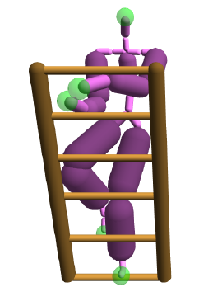
GLI-Based Local Principal Component Analysis (LPCA)
With a set of K nearest sample in similar GLI values, reducing the joint angle of the postures into N dimension
  Using PCA
  No need to consider object interaction anymore as objects are not controllable
  N = 30 in our experiments
Low dimensional local space known as the natural posture space

Slide 13
Posture Synthesis in the
Natural Posture Space
Optimizing a posture based on:
  A given user interaction and
  The low dimensional natural posture space created by LPCA
Minimizing 3 energy terms and satisfying 1 constraint
  Topology term: Minimizing change of topology during posture optimization
  Continuity term: Reducing positional differences between the current pose and the previous pose
  Style term: Encouraging optimization to be performed at the center of the low dimensional space
  Positional constraint for user controlled joints
Restoring the full dimensional posture after finding a solution in the natural posture space

Slide 14
Experiment on IK Movement Control
Chai and
Hodgins 05
18ms per frame
Our method
20ms per frame

Slide 15
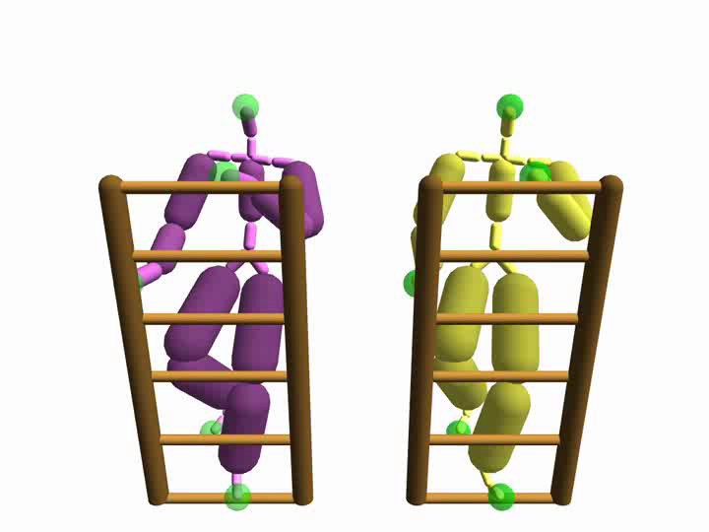
Climbing a Ladder
Chai and
Hodgins 05
16ms per frame
Our method
17ms per frame

Slide 16
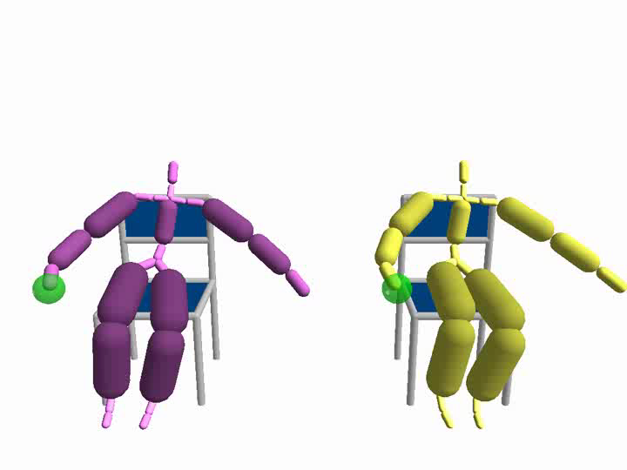
Sitting on a Chair
Chai and
Hodgins 05
27ms per frame
Our method
29ms per frame

Slide 17
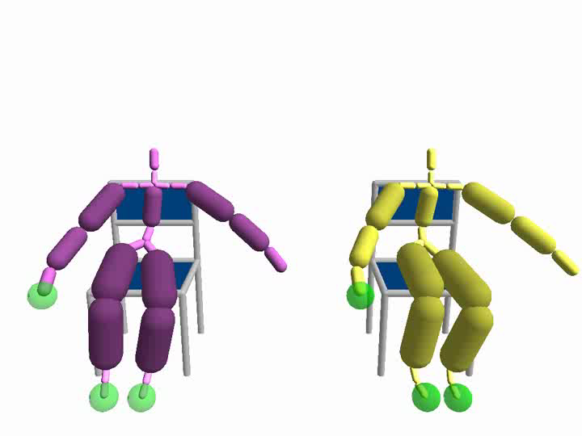
Sitting on a Chair
(More Control Points)
Chai and
Hodgins 05
31ms per frame
Our method
32ms per frame

Slide 18
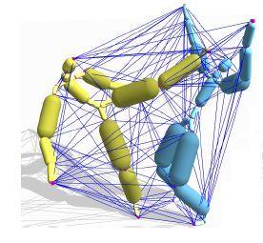
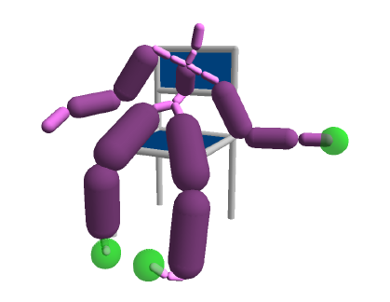
Conclusion and Discussions
Data-driven inverse kinematics based on GLI topology
Potential collision for characters and object in different sizes
  Only guaranteeing non-penetration synthesis
  May consider the Interaction Mesh structure
May fail when no similar posture can be found

Slide 19
Thanks!
Any Questions?

