Slide 1

A Dual-Stream Recurrent Neural Network for
Student Feedback Prediction using Kinect
Shanfeng Hu, Hindol Bhattacharya, Matangini Chattopadhyay, Nauman Aslam,
Hubert P. H. Shum
Director of Research and Innovation
Computer and Information Sciences
Northumbria University, UK

Slide 2

E-Learning
E-learning is revolutionizing traditional classroom-based learning paradigms
Accurate and timely student feedbacks enable adaptions and fine-tunings of online learning materials

Slide 3

Traditional Questionnaires
Questionnaires require intensive human efforts to collect and analyze
Questionnaires also cannot provide on-time student feedbacks

Slide 4

Traditional Questionnaires
Questionnaires require intensive human efforts to collect and analyze
Questionnaires also cannot provide on-time student feedbacks
We wish to “tell” feedbacks from students’ facial expressions automatically using Kinect
Microsoft Kinect

Slide 5
Our Goal and Contributions
Goal
  A machine learning system that predicts a student’s course satisfaction level (0-9) from his/her Kinect-captured facial expressions

Slide 6
Our Goal and Contributions
Goal
  A machine learning system that predicts a student’s course satisfaction level (0-9) from his/her Kinect-captured facial expressions
Contributions
  We build an expression-based database of student feedbacks
  We propose a recurrent neural network (RNN) that combines Kinect color and depth streams for feedback prediction
  We validate the effectiveness of the proposed dual-stream RNN

Slide 7
The Student Feedback Database
Participants
  22 voluntary undergraduate and master students from Jadavpur University (15 males and 7 females, ages from 20 to 25)
Platform
  Teaching Resources and Interactive Laboratory Simulations (TRAILS, http://trails.jdvu.ac.in/290617) from Jadavpur University
Learning Modules
  Theory, Video, Animation, and Simulation modules for teaching the participants about the ceiling fan

Slide 8

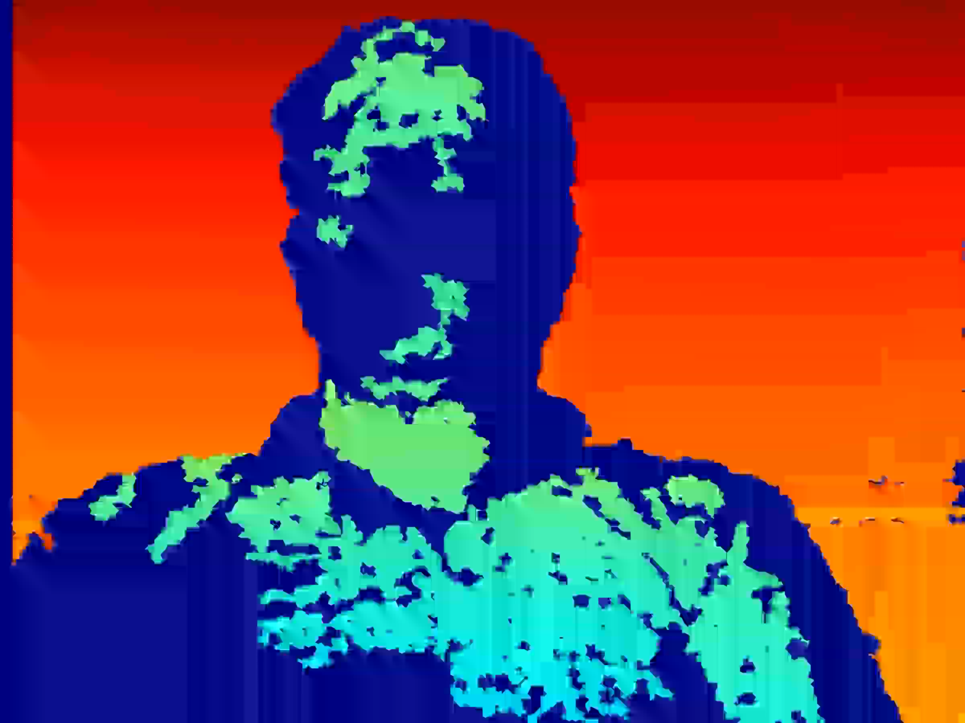
The Student Feedback Database
Kinect was used to capture each student’s facial color and depth images while he/she was using each module
A score was provided by the student for the module
Over 10,000 annotated color and depth streams after frame sampling
An example colour and depth stream from the database

Slide 9
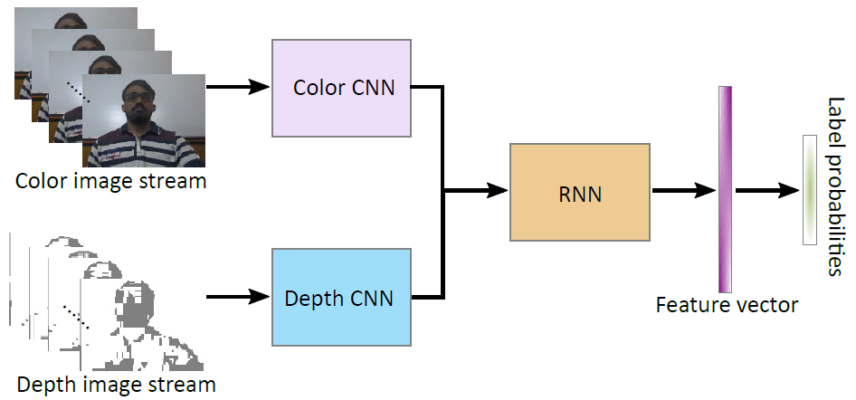
Overview of The Proposed System
The two convolutional neural networks (CNNs) extract per-frame facial features and the RNN integrates all frame features for feedback score prediction

Slide 10
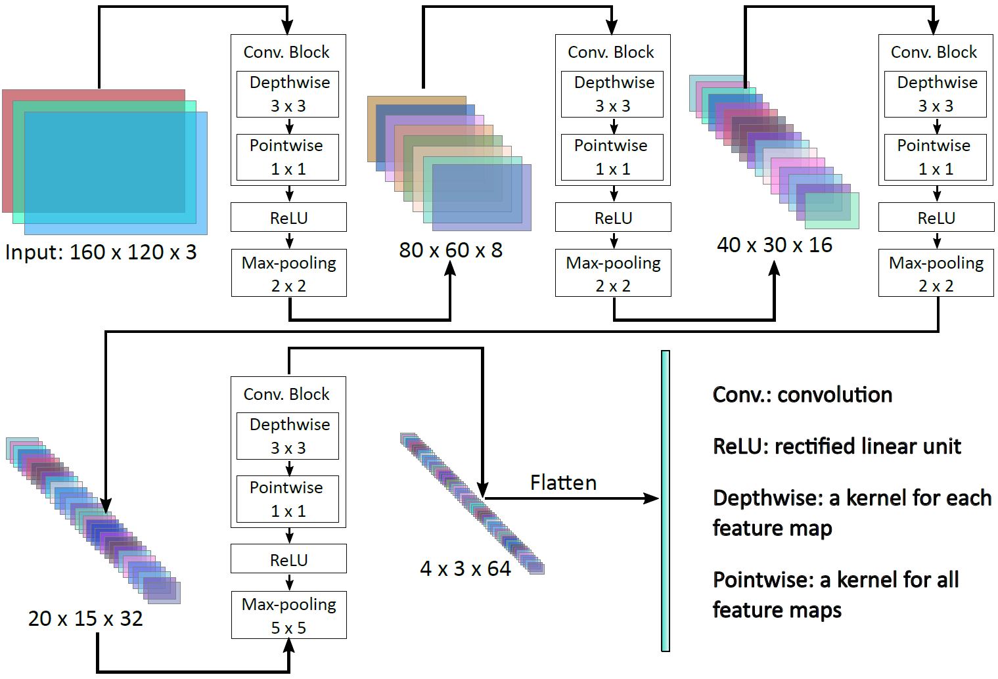
The CNN Architecture
The colour (or depth) CNN has a few blocks of depth-wise convolution, point-wise convolution, ReLU activation, and max-pooling for per-frame feature extraction

Slide 11
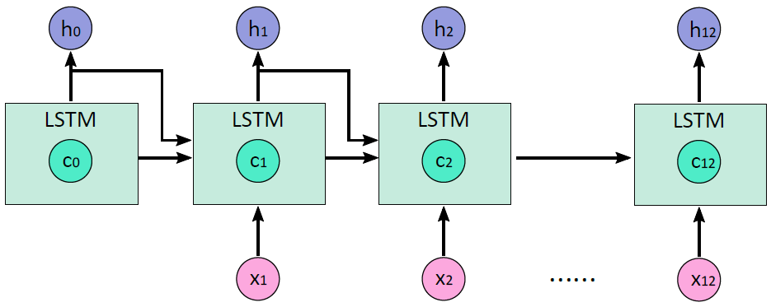
The RNN Architecture
Hidden states
Input feature vectors of each frame
The RNN has a long-short term memory (LSTM) cell for integrating the colour and depth CNN features of all frames for temporal feature extraction

Slide 12
The RNN Architecture
The last hidden state for feedback score prediction
Hidden states
Input feature vectors of each frame
The RNN has a long-short term memory (LSTM) cell for integrating the colour and depth CNN features of all frames for temporal feature extraction

Slide 13
Results
Feedback prediction accuracy using two CNNs and a LSTM of 12 steps

Slide 14
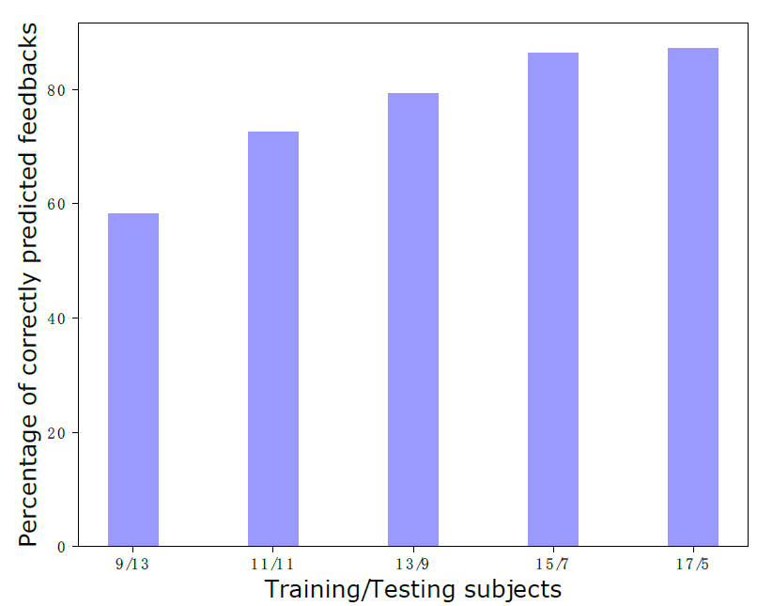
Validations – Effect of Training Data
Comparison of feedback prediction accuracy given different partitions of
training and testing subjects

Slide 15
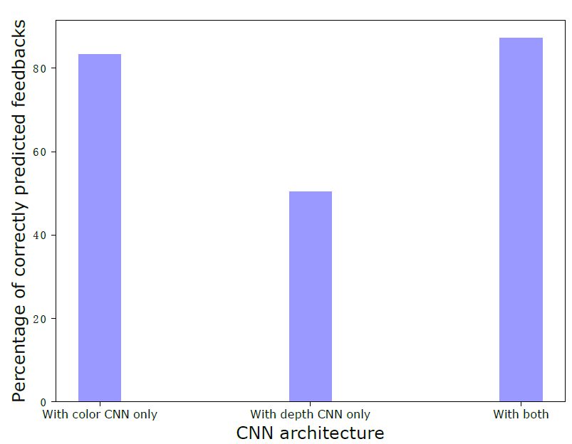
Validations – Effect of CNNs
Comparison of feedback prediction accuracy between using a single CNN
or two CNNs together

Slide 16
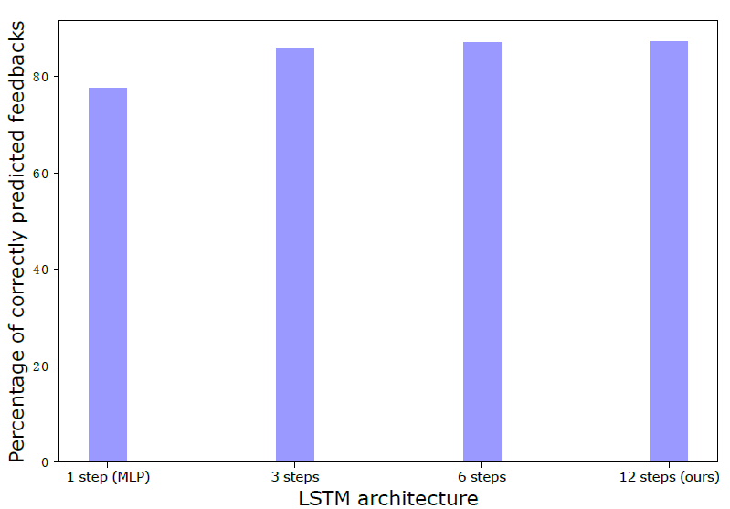
Validations – Effect of LSTM
Comparison of feedback prediction accuracy using different numbers of LSTM steps for temporal feature learning

Slide 17
Future Directions
Enlarging the database by incorporating more subjects and learning modules
Annotating sub-parts of learning durations for finer-grained feedback prediction

Slide 18
Conclusion
We created a feedback database of 22 subjects, 4 learning modules, and over 10,000 annotated colour and depth streams
We proposed a dual-stream CNN-LSTM that achieved an 87.21% feedback prediction accuracy using 17 out of 22 subjects for training

Slide 19
Acknowledgement
Erasmus Mundus Action 2 Programme, €3.03 million, Ref: 2014-0861/001-001
Royal Society, £11,841, Ref: IE160609
Engineering and Physical Sciences Research Council (EPSRC), £124,000, Ref: EP/M002632/1
University Grants commission UPE Phase II Scheme from the Government of India

Slide 20
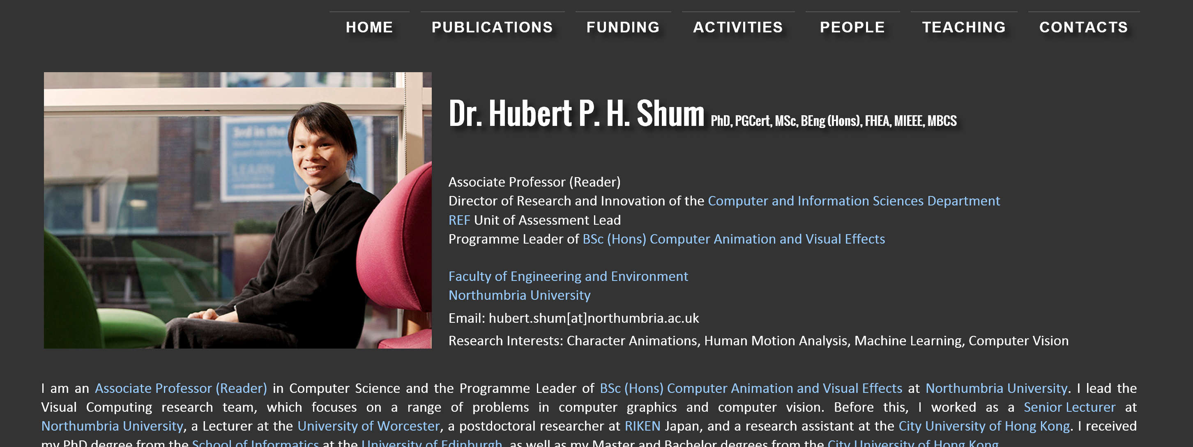
One Last Thing
http://info.hubertshum.com

Slide 21
Thanks!
Any Questions?

