Slide 1
Simulating Interactions Among
Multiple Characters
Hubert P. H. Shum
School of Informatics
University of Edinburgh

Slide 2
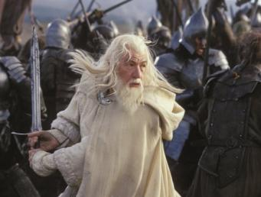
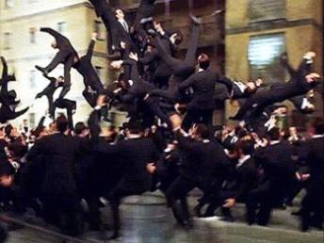
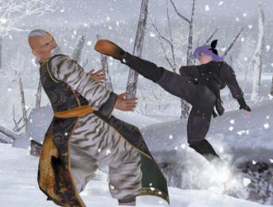
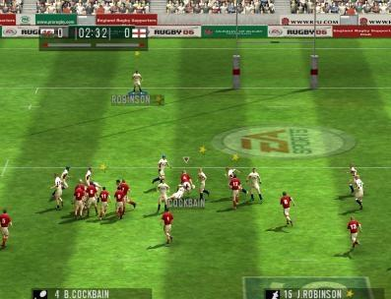
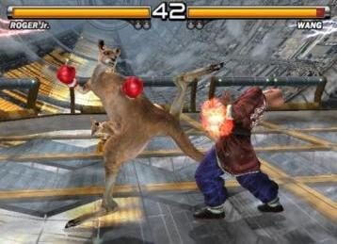
Dense Interaction Among Characters

Slide 3
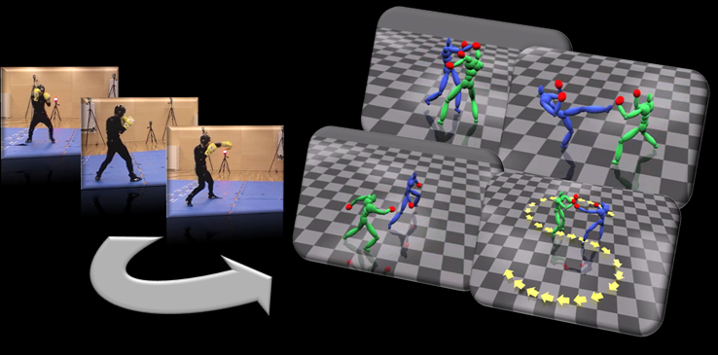
In This Thesis…
Simulate interactions from singly captured motions
Precompute interactions for real-time applications
Simulate interactions for a crowd

Slide 4
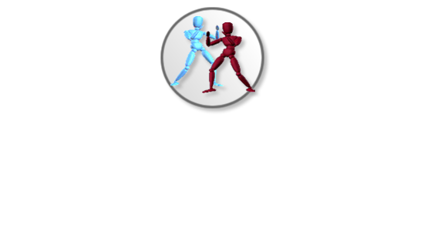
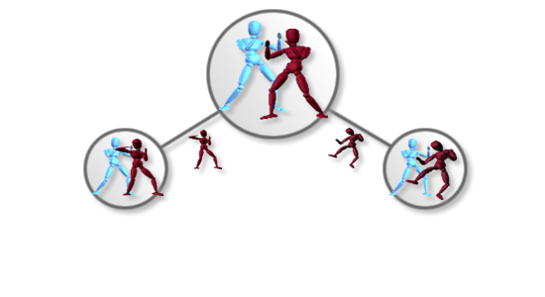
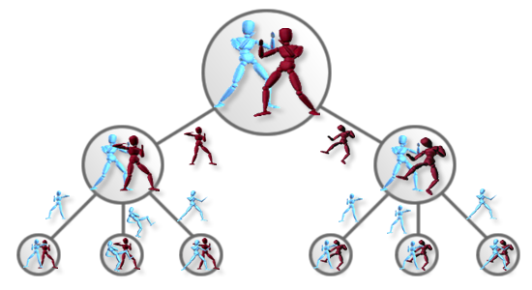
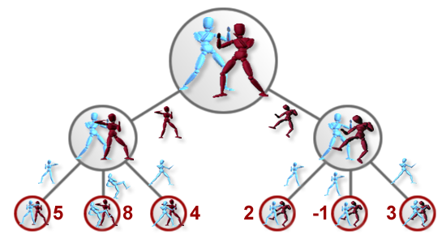
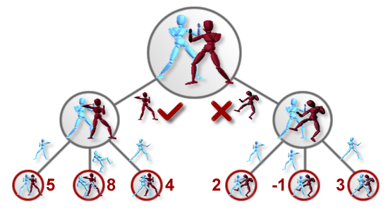
Game Tree Expansion

Slide 5
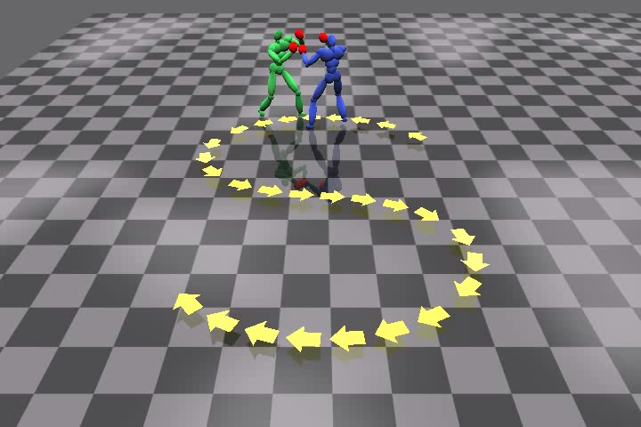
Multi-Modal Characters by
Temporal Tree Expansion

Slide 6
Contributions
Propose a method to simulate dense interactions of intelligent characters
  Use game theory such as tree expansion
Propose a multi-modal approach to enable the characters competing while cooperatively achieving common goals

Slide 7
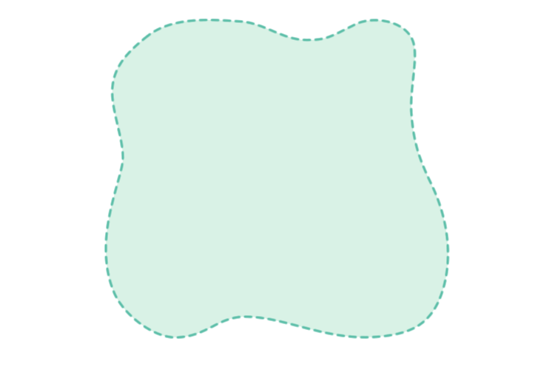
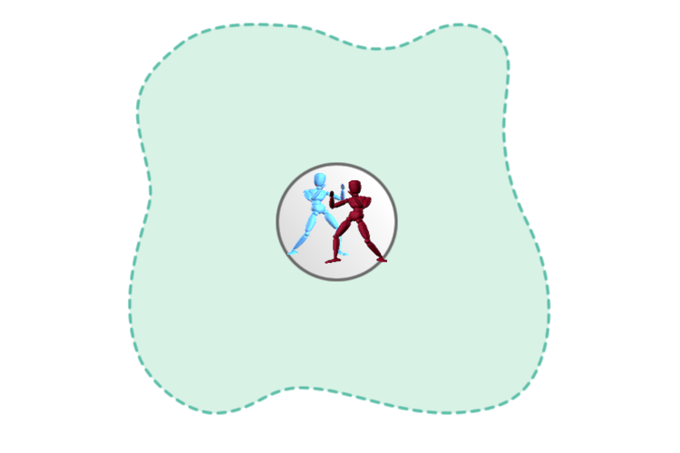
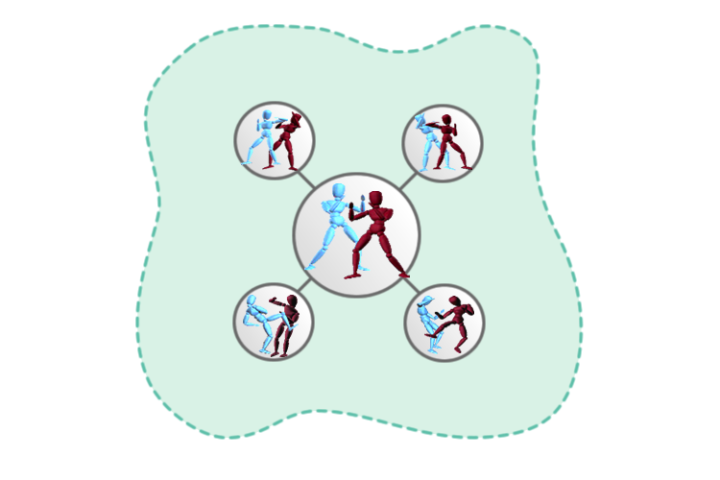
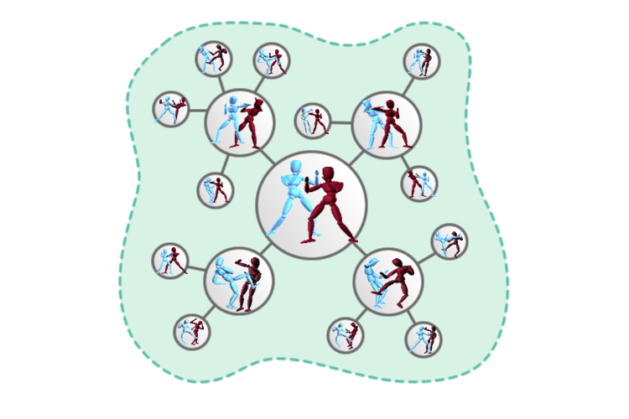
Sampling State Space

Slide 8
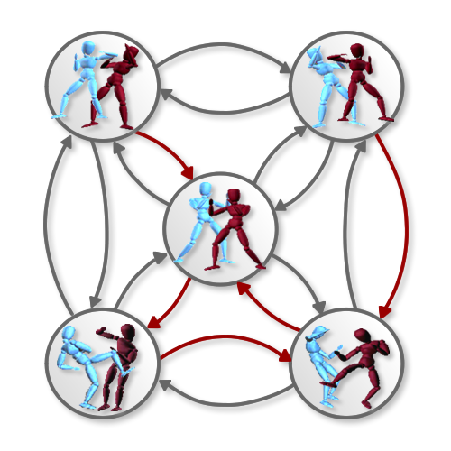
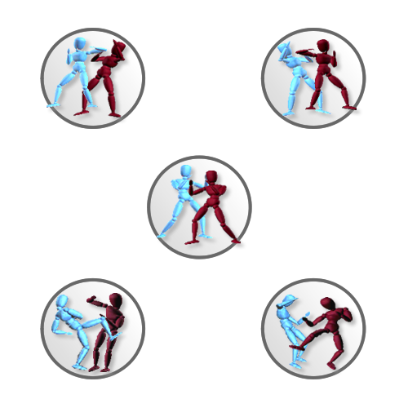
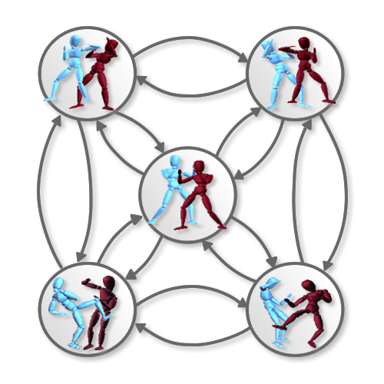
Interaction Graph

Slide 9
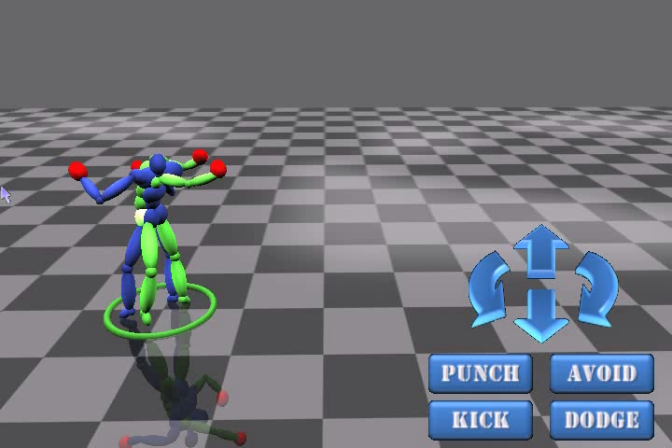
Real-time Interaction by
Interaction Graph

Slide 10
Contributions
Propose an off-policy learning approach to sample a huge state space
  Using criteria that favor states with good connectivity and more interactions
Propose a finite state machine called Interaction Graph to precompute the optimal actions for a character
  Apply for both collaborate and competitive interactions

Slide 11
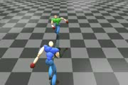
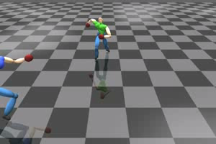
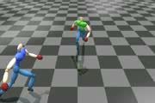
Temporal Concatenation

Slide 12
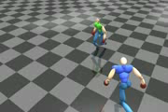
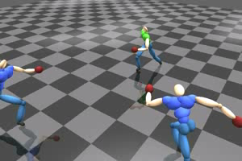
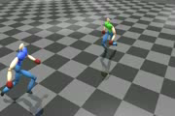
Spatial Concatenation

Slide 13
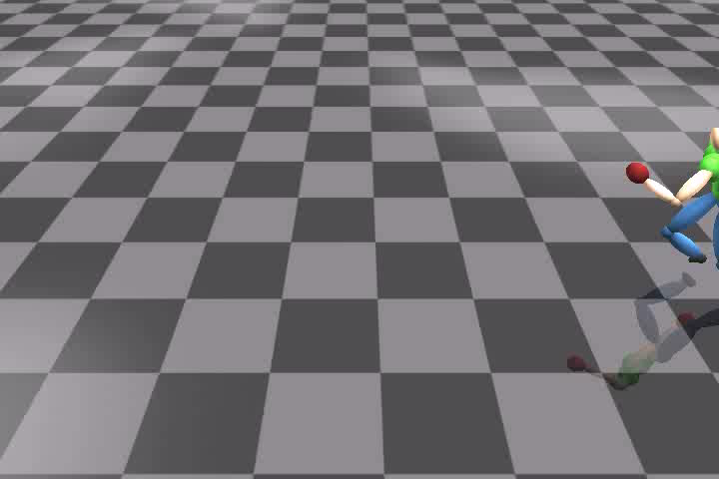
Crowd Interactions by
Interaction Patches

Slide 14
Contributions
Propose a method to synthesize realistic interactions and stored as a connectable patch format
  Precompute interactions between two characters for a short duration
Propose an algorithm to synthesize a large-scale scene where the characters interact with each other
  Spatio-temporally concatenate Interaction Patches

Slide 15
Conclusions
Temporal Tree Expansion
  Create multi-modal characters to complete with each other while following cooperative objectives
Interaction Graph
  Precompute interactions and create characters that can act at real-time
Interaction Patches
  Precompute interactions as a connectable patch format and create crowd interactions

Slide 16
The End
Thanks

